Slide 1
CS112: Compositing Techniques

Slide 2
Announcements
PA2 will be due next week
Please start early and use Piazza for discussions!
Friday’s discussion sessions
No official presentations
You are encouraged to attend to get TA time!

Slide 3
The Alpha Channel
In addition to RGB, the fourth color channel
Used for alpha blending
GL_BLEND in OpenGL
Application can control the value of alpha at every pixel (the same way as for RGB)

Slide 4
Compositing Functions
Source color: associated with the current fragment
S = [s_{r}, s_{g}, s_{b}, s_{a}]
Destination color: associated with a pixel in the frame buffer
D = [d_{r}, d_{g}, d_{b}, d_{a}]
When a fragment with color S is written into a pixel with color D in the frame buffer, the pixel color changes to: D’ = f_{s}(s_{a},d_{a}) S + f_{d}(s_{a},d_{a}) D
Compositing function
Compositing function

Slide 5
Transparency
D’ = s_{a}S + (1 - s_{a})D
f_{s}(s_{a},d_{a}) = s_{a} (GL_SRC_ALPHA)
f_{d}(s_{a},d_{a}) = 1 - s_{a} (GL_ONE_MINUS_SRC_ALPHA)
Color of the fragment being rendered is scaled by s_{a}
Color existing in the framebuffer scaled by (1 - s_{a})
Opaque fragments have s_{a} = 1
Framebuffer gets overwritten
Transparent fragments have s_{a}= 0
Framebuffer remains unchanged
Translucent fragments have 0 < s_{a} < 1
Color gets blended

Slide 6
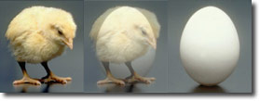
Transparency
Chicken = 1, Egg = 0
Chicken = 0.5, Egg = 0.5
Chicken = 0, Egg = 1

Slide 7
Order Matters
A: opaque (alpha = 1)
B, C: transparent (alpha < 1)
A “blocks” B and C, wrong!
A
3
B
1
C
2
Image Plane

Slide 8
Order Matters
A: opaque (alpha = 1)
B, C: transparent (alpha < 1)
B “leaks” through A, wrong!
B
3
A
1
C
2
Image Plane

Slide 9
Order Matters
Render opaque objects first (occlusion resolved)
Render translucent objects from back to front
B
2
A
1
C
3
Image Plane

Slide 10
Order Matters
Render opaque objects first (occlusion resolved)
Set depth buffer to read-only
Retains the depth of opaque objects only
Render translucent objects from back to front
Only for fragments passing the depth test (i.e., not behind any opaque objects)

Slide 11
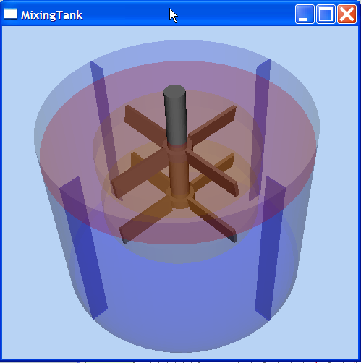
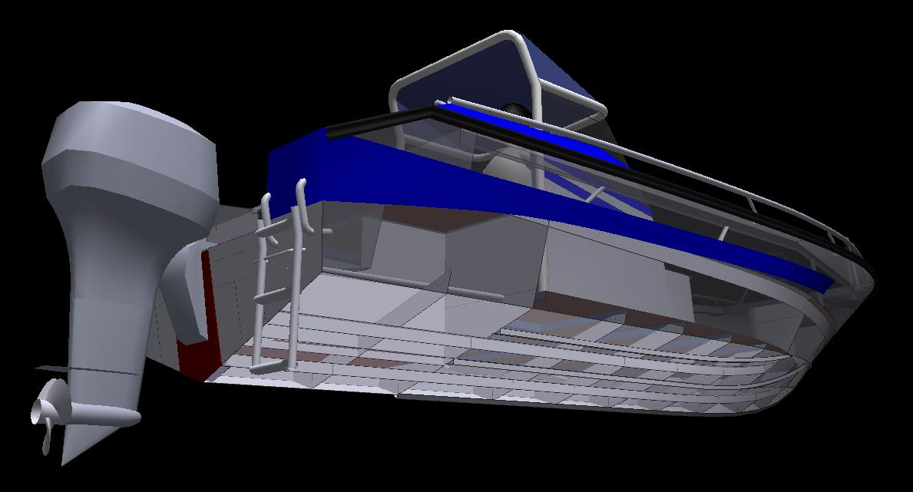
Results

Slide 12
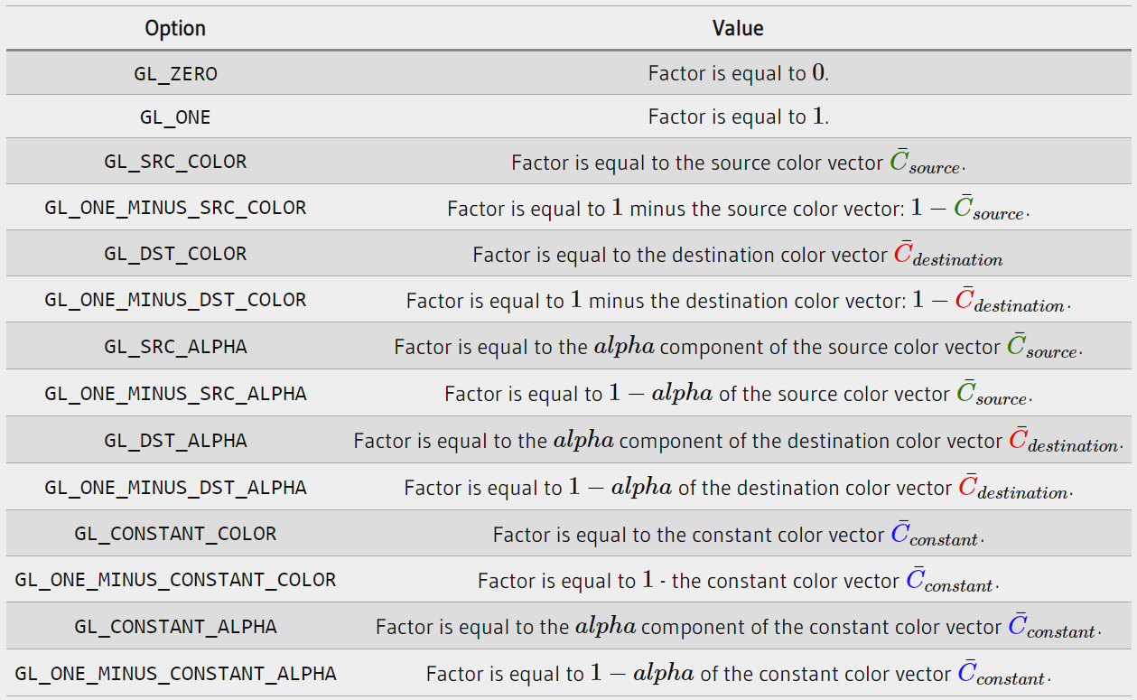
Other Compositing Functions
[learnopengl.com]

Slide 13
CS112: Projective Textures
Shuang Zhao
Assistant Professor of Computer Science
University of California, Irvine

Slide 14
Project a texture on 3D object
3D object
Viewer
Texture
Point of projection

Slide 15
Multi-Pass Rendering
Projective textures are used to achieve complicated visual effects like:
Textured illumination (i.e., virtual projector)
Shadows
Generally requires more than one rendering passes
Output of one pass is used in successive pass or passes

Slide 16
Designing Theatres
Simulate what the viewer sees
Texture map screen using projected texture from projector
Render the screen from the viewer
Screen
Projector
Viewer

Slide 17
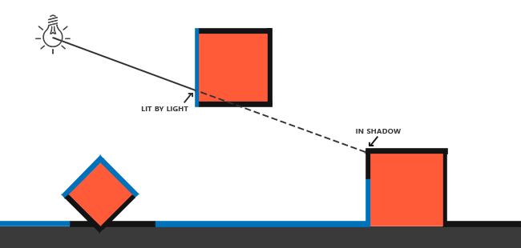
Shadows
Key idea: points visible to the eye but invisible to the light are in shadow
In contrast, points visible to both the eye and the light receives direct illumination and are not in shadow
[learnopengl.com]

Slide 18
Shadow Mapping
B is not getting light and hence in shadow
How to achieve the effect?
Shadow mapping
B
A
Viewer
Light

Slide 19
Rendering Pass 1
Render the scene from light
Z_{L} = The depth buffer gives the depth of the points that are lit
Save the depth buffer
Need to use frame buffer objects (FBO) in OpenGL
B
A
Viewer
Light

Slide 20
Rendering Pass 2
Render from the eye
For each surface point (visible from the eye), compute its depth when viewed from the light source
How? (Using the light’s projection transformation)
Compare this depth with the stored one from Pass 1
> stored depth, shadow
= stored depth, lit
B
A
Viewer
Light

Slide 21
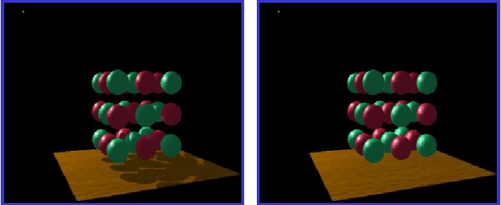
Results
With shadow
No shadow

Slide 22
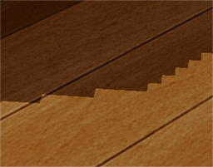
Shadow Mapping Remarks
Creates “hard shadows”
Fast but not very accurate: shadows can look pixelated when the shadow map has insufficient resolution
Prefiltering the shadow map helps reducing such artifacts

