Slide 1
CS112: Sampling and Aliasing
Shuang Zhao
Assistant Professor of Computer Science
University of California, Irvine

Slide 2
Analog vs Digital
Nature is analog signal
We discretize to create digital signals

Slide 3
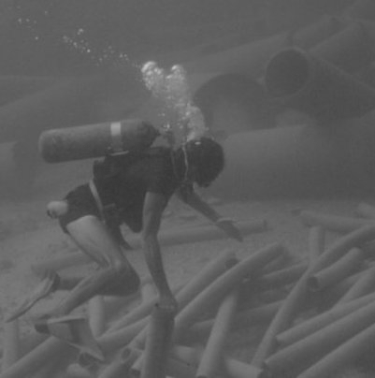
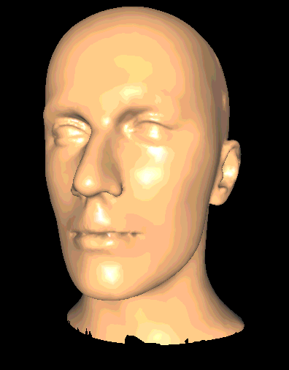
Analog signals
Function dependent on single or multiple variables
Defined at any value of the independent variables
3D:
1D:
2D:
y
Amplitude
y
t
x
x
z

Slide 4
Digital Signals
Defined at only few values of t
t
Sampling
Correct Reconstruction

Slide 5
Digital Signals
Whether you can reconstruct correctly depends on how you sample – sampling rate
t
Sampling
Incorrect Reconstruction

Slide 6
Nyquist Rate
Consider only sine waves
If you sample at least at twice the frequency (2 samples per cycle), signal can be reconstructed correctly
Higher the sampling rate, better the reconstruction
If less than twice the frequency, cannot reconstruct correct

Slide 7
Nyquist Rate Sampling
t
Sampling
Correct Reconstruction

Slide 8
Aliasing
Aliasing: Incorrect representation of some entity
A much lower frequency
Zero frequency

Slide 9
How does sinusoids help?
Any signal can be expressed as a sum of sinusoids of different frequencies
Amplitude
Phase
Fourier transform

Slide 10
Spectral Analysis
Time Domain
Frequency Domain

Slide 11
For 2D images
Any signal can be expressed as a sum of sinusoids of different frequencies
Amplitude
Phase
Orientation

Slide 12
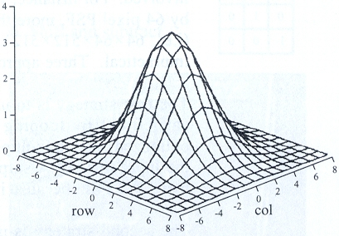
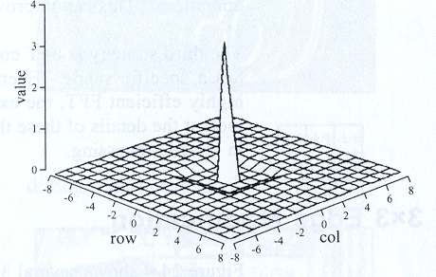
Extending it to 2D
Amplitude
Phase

Slide 13
Frequency Content
Lower frequencies : Global Pattern
Higher frequencies : Details
Required sampling rate lower for low frequency image (lower number of pixels, lower resolution)

Slide 14
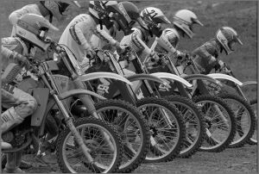
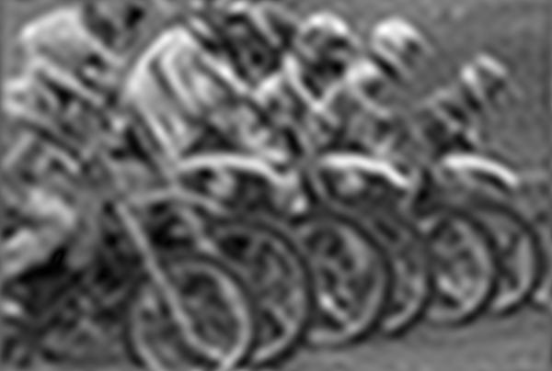
Amplitude
Amplitude
How much details?
Sharper details signify higher frequencies
Will deal with this mostly

Slide 15
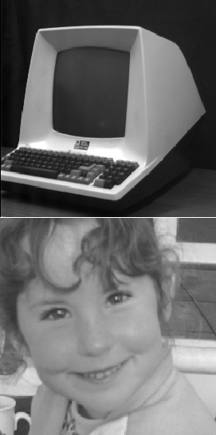
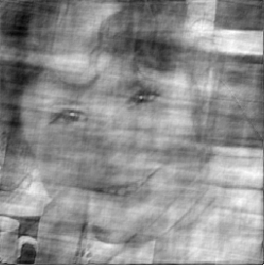
Phase
Where are the details?
Though we do not manipulate it much, it is important to have the phase correct

Slide 16
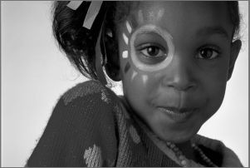
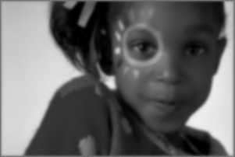
Reducing Frequency Content
Filtering: Applying mathematical function over a window around every pixel
Simplest: Averaging pixels (Box Filter)
Other sophisticated methods
Size of the window used
Mathematical function used is more complicated

Slide 17
How does it help?
Filtering reduces frequency content.
Hence, lower sampling is sufficient.
Input (256 x 256)
Filtered (256 x 256)
ANTI-ALIASING
Insufficient sampling.
Hence, aliasing.
Subsampled(128 x 128)
Subsampled from filtered image(128 x 128)
(This is also why prefiltering helps)

Slide 18
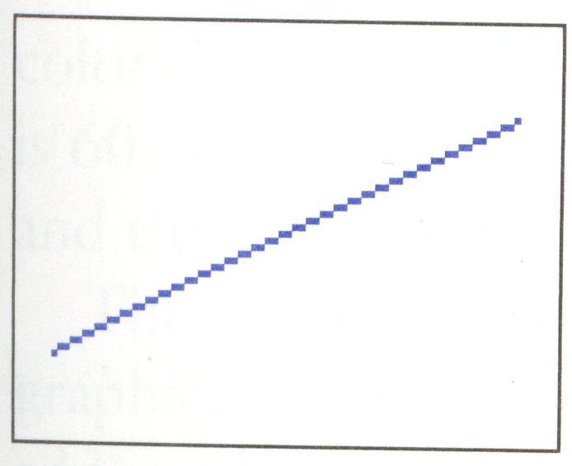
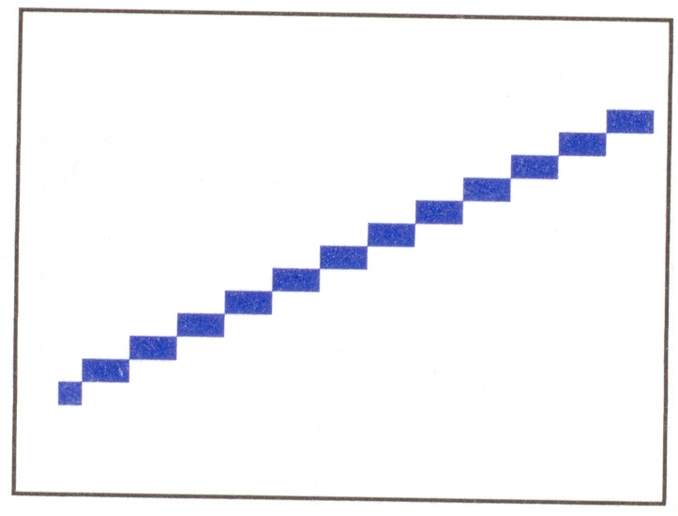
Aliasing in Scan Conversion
Rasterized line segments and edges of polygons look jagged

Slide 19
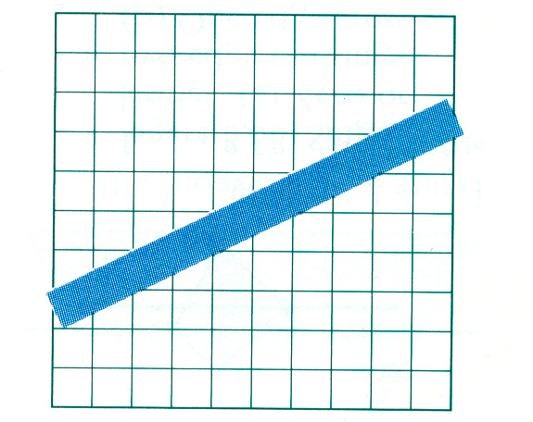
Aliasing in Scan Conversion
1-pixel wide ideal line span partial pixels
Scan conversion method forces us to choose exactly one pixel for every value of x

Slide 20
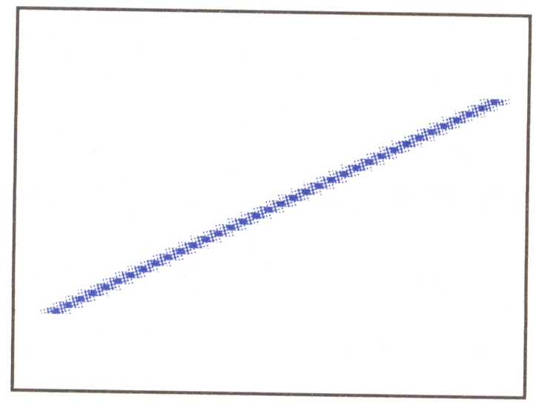
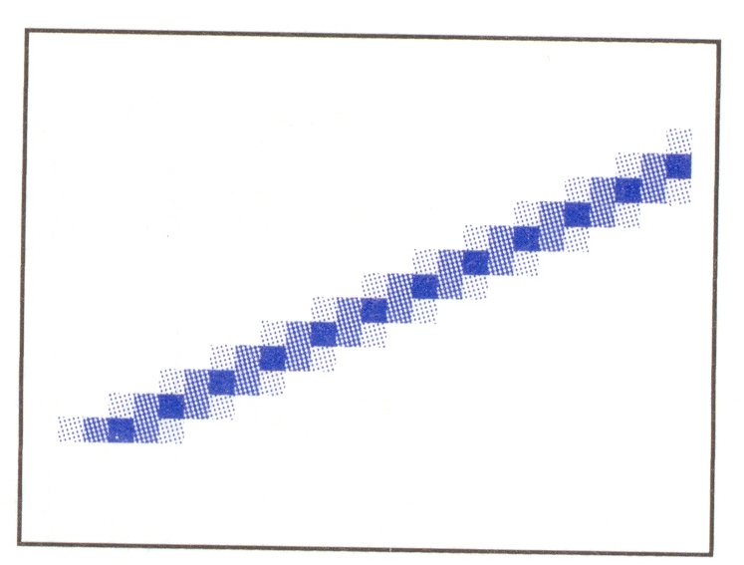
Aliasing in Scan Conversion
Supersampling and Filtering: Render a super-sampled image and then filter
Area Averaging: Shade each pixel by gray value = the percentage of the actual line crossing it at x

Slide 21
Aliasing in Scan Conversion
Expensive: need powerful graphics hardware for real-time applications (e.g., video games)
Very common in offline rendering applications (e.g., CG movies)

Slide 22
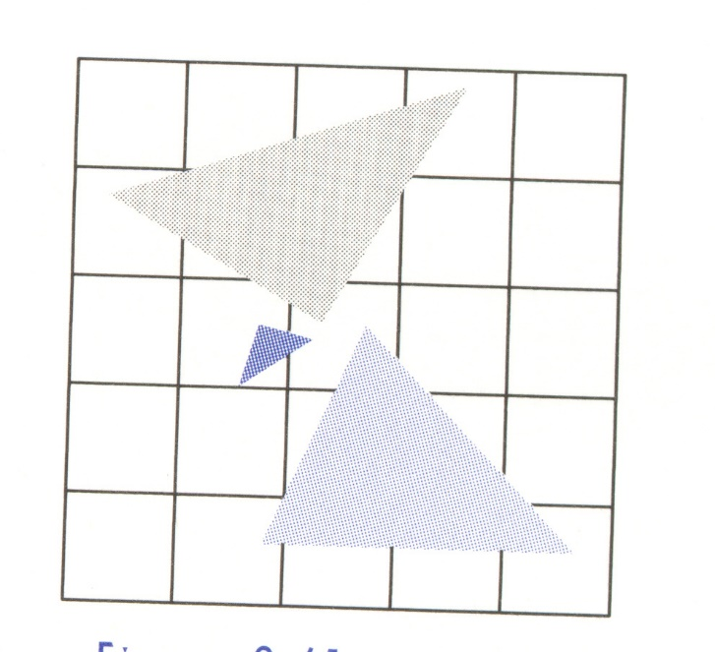
Aliasing during z-buffering
A pixel shared by three primitives
Z intersection – identified in an integer level
Front-most gets drawn
Same technique: Area weighted average

Slide 23
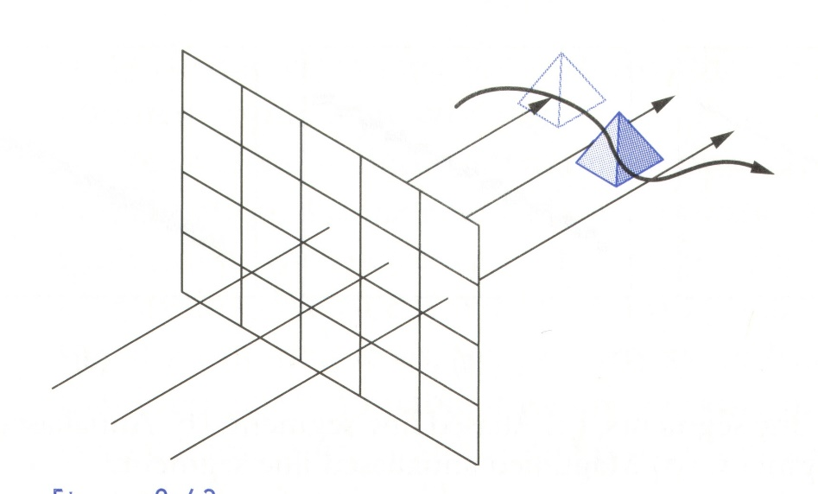
Temporal Aliasing
Animation
Speed of the object too fast
Jittered Motion

