Slide 1
CS112: Color
Shuang Zhao
Assistant Professor of Computer Science
University of California, Irvine

Slide 2
Announcements
PA2 due this Wednesday at 11:59 pm
  Please remember to submit your work in time!
  (We only accept one late submission.)
Midterm exam next Tuesday (Nov 12)
  In class, closed book
  Mostly about concepts and simple derivations
  Covers all topics up to this lecture
    i.e., interactive graphics pipeline, transformations, shading, …
    Brief review on Thursday

Slide 3
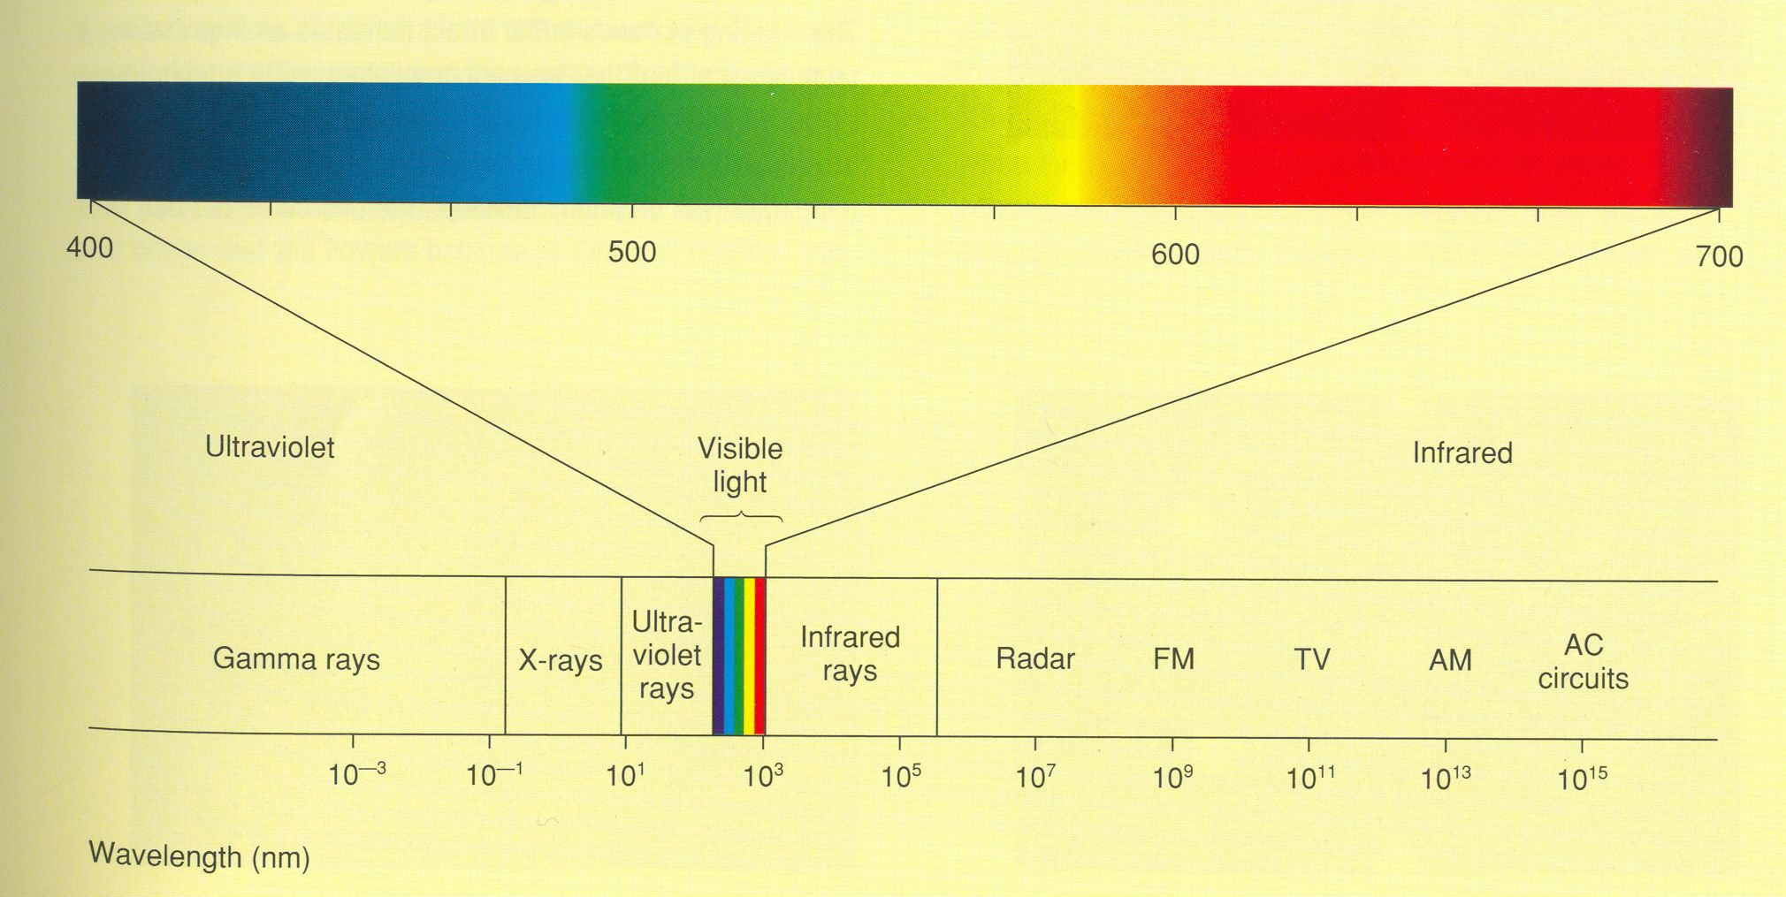
Visible Light Spectrum
Light is one type of electromagnetic wave

Slide 4
Color is due to..
Selective emission/reflection of different wavelengths by surfaces in the world
Different response to different wavelengths of the eye

Slide 5
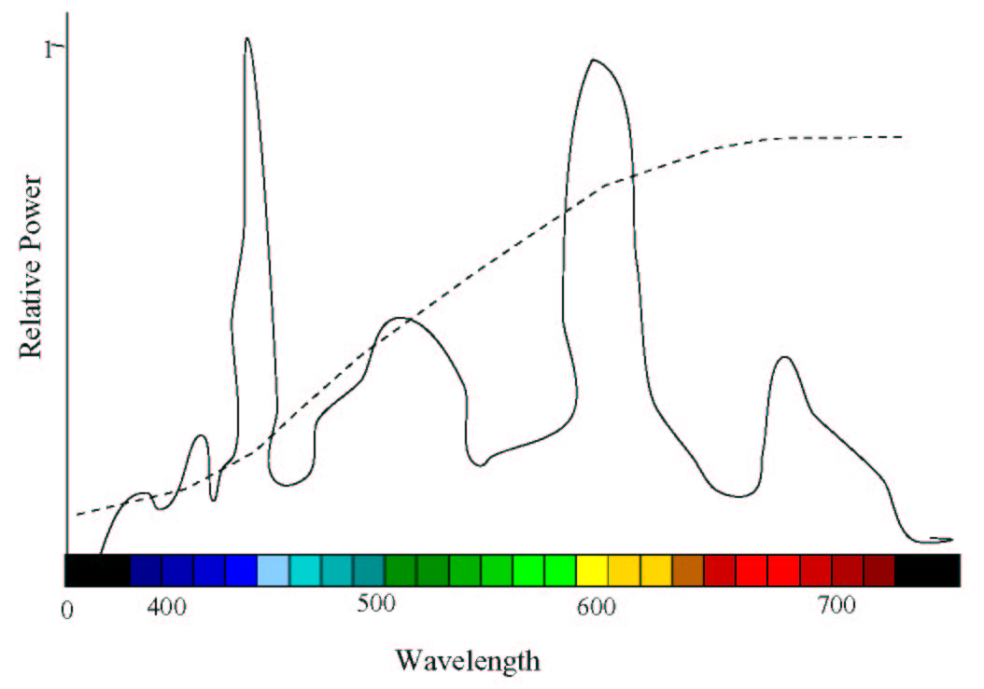
Illumination – I(λ)

Slide 6
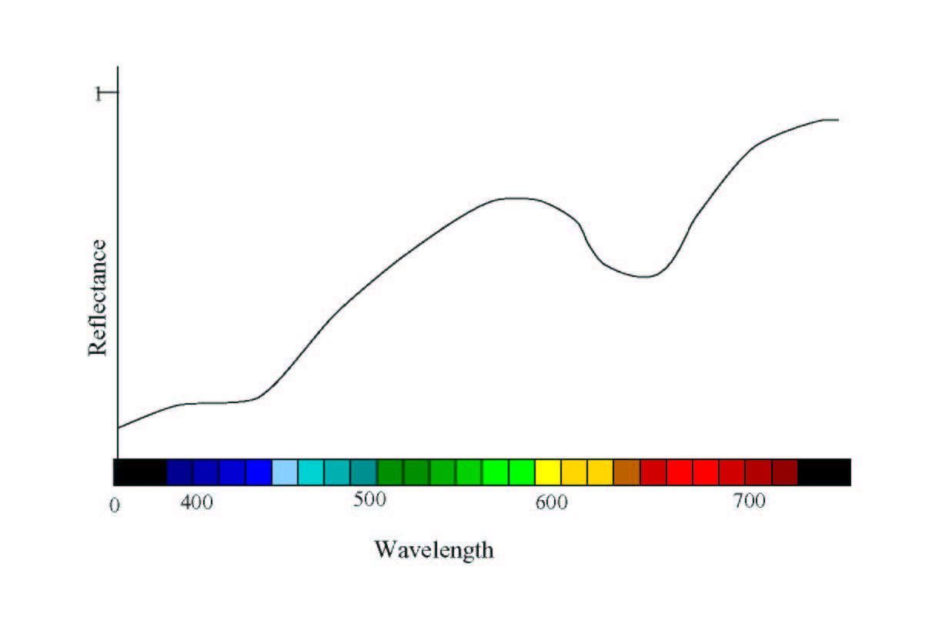
Reflectance – R(λ)
(Can be directionally dependent)

Slide 7
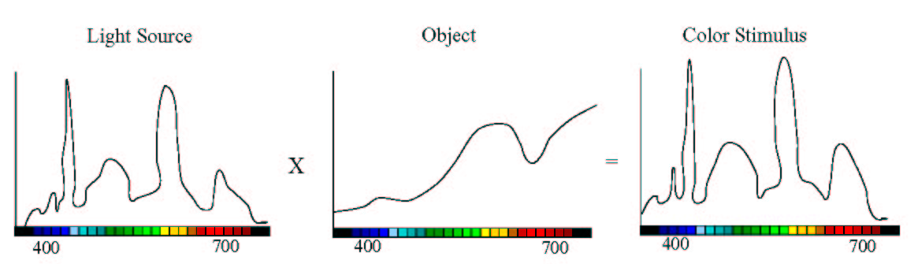
Color Stimuli – C(λ)
(Can be directionally dependent)
I(λ) x R(λ) = C(λ)

Slide 8
Color Mixtures
Subtractive
  Intersection of two spectrums C₁(λ) and C₂(λ)
  In paints
C₁(λ)
C₂(λ)
Power
Wavelength

Slide 9
Color Mixtures
Additive
  Addition of two spectrums C₁(λ) and C₂(λ)
  In light
C₁(λ)
C₂(λ)
Power
Wavelength

Slide 10
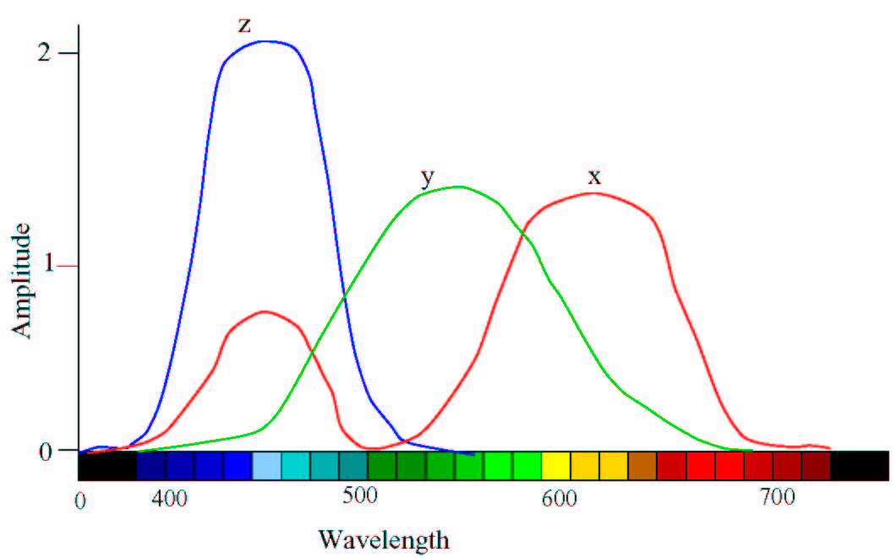
CIE Functions for Standard Observer

Slide 11
Tristimulus Values
Integration over wavelength

Slide 12
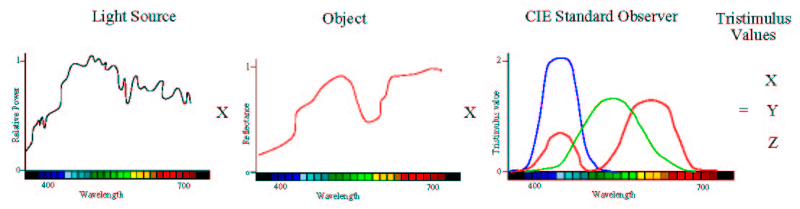
Tristimulus Values

Slide 13
Metamerism
Two different color stimuli can generate same tristimulus values
  Metamers
  Evoke same response in the eye
This is why RGB displays work!

Slide 14
Tristimulus Values
XYZ forms a three dimensional space to define color
Two colors added by just adding the XYZ coordinates

Slide 15
Tristimulus Values
The intensity of x(λ), y(λ) and z(λ) combining which would create a metamer of the spectrum
Since normalized, it signifies proportions
  Correct upto a scaling factor

Slide 16
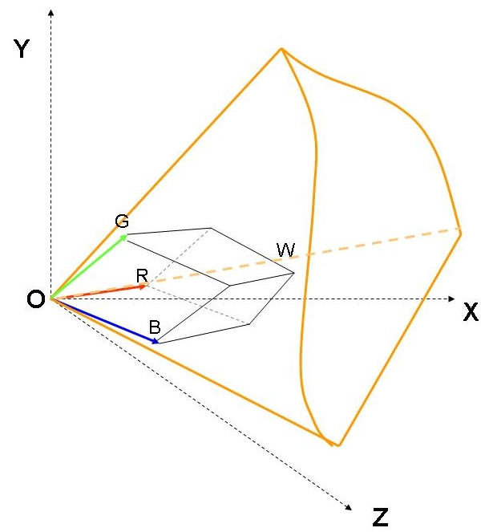
How does this space look?

Slide 17
Different Types of Color
Monochromatic
  Laser
Achromatic
  Sunlight (close to)
Polychromatic
  Most common

Slide 18
Properties of Color
Intensity
  Amount of stimulus in cd/m²
  The absolute brightness
  Governed by the area under the curve

Slide 19
Properties of Color
Hue
  Predominant wavelength
  Mean

Slide 20
Properties of Color
Saturation
  Amount of achromatic light
  Variance from the mean
All these three parameters are interrelated. Cannot be changed independently

Slide 21
How to define these using XYZ?
Intensity
  X+Y+Z
Luminance
  Response of the green cones
  Perceived Brightness
  Y
Hue and Saturation (Chrominance)
  Using chromaticity coordinates

Slide 22
Chromaticity Chart
Relative proportions of X, Y, and Z are more important
Achromatic Color
  Equal proportions of X,Y and Z
Chromaticity Chart
  2D projection of 3D colors on X+Y+Z = d plane
Plot of x and y is the chromaticity chart
x = X/(X+Y+Z)
y = Y/(X+Y+Z)

Slide 23
Chromaticity Chart
Points on a vector originating at zero coincide at the same point
  (X,Y,Z) and (2X,2Y,2Z) generate same (x,y)
Colors on this vector have different intensity but same chrominance

Slide 24
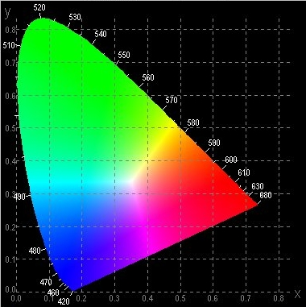
Chromaticity Coordinates
Shows all the visible colors
Achromatic Colors are at (0.33,0.33)
  Why?
  Called white point
The saturated colors at the boundary
  Spectral Colors
White Point

Slide 25
Chromaticity Chart
Exception is purples
  Non-spectral region in the boundary
All colors on straight line from white point to a boundary has the same spectral hue
  Dominant wavelength
P
White Point

Slide 26
Chromaticity Chart
What happens here?
  Complimentary wavelength
  When mixed generate achromatic color
Purity (Saturation)
  How far shifted towards the spectral color
  Ratio of a/b
  Purity = 1 implies spectral color with maximum saturation
B
B’
b
P
a
P
White Point (W)

Slide 27
How to combine colors?
Using XYZ
  Just add them
Using intensity and (x,y)
  Sum (x,y) weighted by proportions of their intensities to generate new (x,y)
  Add the intensities to generate new intensity
What happens when add two colors of same hue and saturation?
  Only adds their intensities

Slide 28
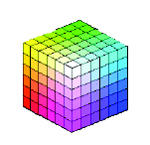
Additive Color Generation
Take three primary colors (R, G, B)
Add them in different amounts to generate a color

Slide 29
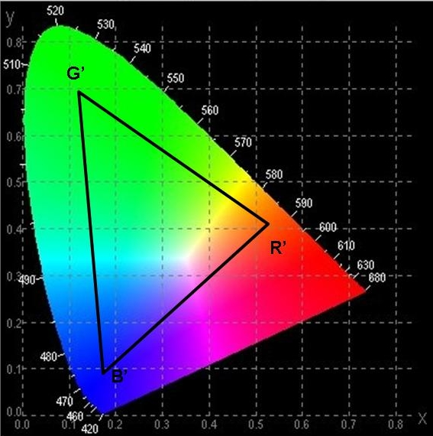
2D Color Gamut
Projection of 3D gamut on X+Y+Z=d plane
It is a triangle on the chromaticity charts
Shows reproducible the hue and saturation
Examples:
  sRGB, aRGB, DCI-P3

Slide 30
Different Display Devices
Differs only in the primaries used
  Have different spectrums
Can be converted to each other via a linear transformation
  Expressed using a 3x3 matrix
Conversion between RGB and XYZ
  RGB is dependent on device (device dependent color space)
  XYZ depends on eye’s response (device independent color space)

Slide 31
Display/Sensor Model
( X_{g} ,Y_{g},Z_{g} )
Y
( X_{r} ,Y_{r} ,Z_{r} )
Device dependent
X
( X_{b} ,Y_{b} ,Z_{b} )
Z

Slide 32
Linear Devices
[X Y Z 1]^{T} = M [R G B 1]^{T}
Two devices:
  [X Y Z 1]^{T} = M₁ [R₁ G₁ B₁ 1]^{T}
  [X Y Z 1]^{T} = M₂ [R₂ G₂ B₂ 1]^{T}
[R₂ G₂ B₂ 1]^{T} = M₂⁻¹ [X Y Z 1]^{T}
= M₂⁻¹ M₁ [R₁ G₁ B₁ 1]^{T}
Is essentially a transformation of coordinates

Slide 33
Display/Sensor Model

