Slide 1
Color Reproduction

Slide 2
Additive Color Mixture
Additive color mixtures modeled by addition in XYZ space
When spectrums get added
Displays
C₁(λ)
C₂(λ)
Power
Wavelength

Slide 3
Additive Color Mixture
Add (X,Y,Z) coordinates
What does this mean in terms of brightness and chrominance?
Add brightness
Linear combination of chrominance in proportion of the brightness

Slide 4
What is the RGB color?
Y
( X_{g} ,Y_{g},Z_{g} )
( X_{r} ,Y_{r} ,Z_{r} )
X
X = X_{r} X_{g} X_{b} i _{r}
( X_{b} ,Y_{b} ,Z_{b} )
Y = Y_{r} Y_{g} Y_{b} i _{g}
Z = Z_{r} Z_{g} Z_{b} i _{b}
Z

Slide 5
Color reproducibility
Only a subset of the 3D CIE XYZ space called 3D color gamut
Projection of the 3D color gamut on the same plane with normal (1,1,1)
Triangle
2D color gamut
Cannot describe brightness range reproducibility

Slide 6
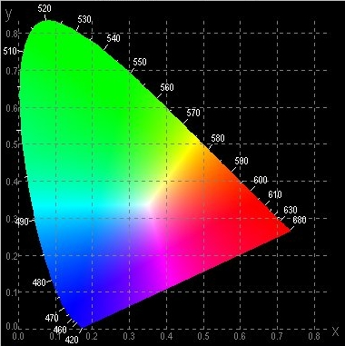
Specification Protocols
Brightness or Luminance
2D gamut
Large if using more saturated primaries

Slide 7
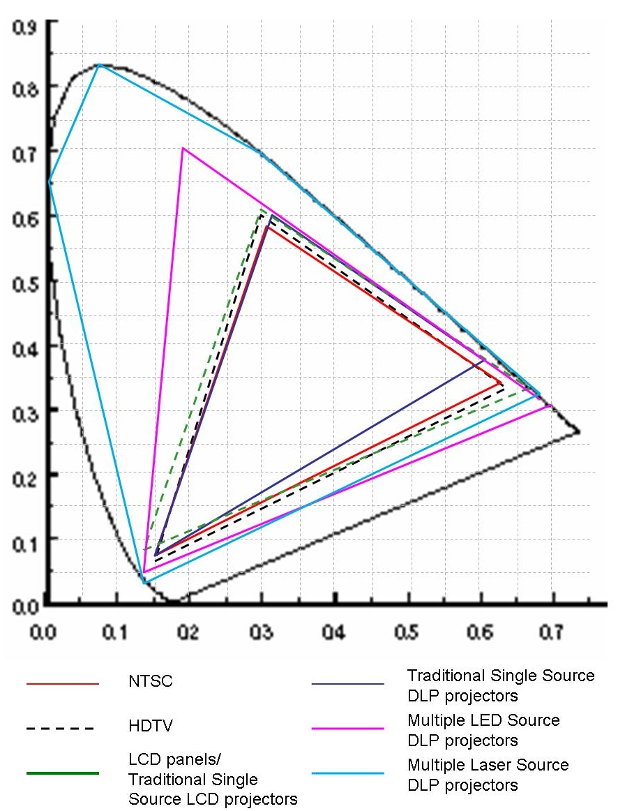
Current standards and devices

Slide 8
Gamut Transformation
Assume linear gamma
[X Y Z 1] ^{T} = M [R G B 1] ^{T}
Two devices
[X Y Z 1] ^{T} = M₁ [R₁ G₁ B₁ 1] ^{T}
[X Y Z 1] ^{T} = M₂ [R₂ G₂ B₂ 1] ^{T}
[R₂ G₂ B₂ 1]^{T} = M₂⁻¹[X Y Z 1]
= M₂⁻¹M₁[R₁ G₁ B₁ 1]^{T}

Slide 9
Gamut Transformation
How to get the matrix from the standard spec?
Given (Y,x,y) or (I,x,y) for the three vectors, you can compute (X,Y,Z)
(x. Y/y, Y, (1-x-y). Y/y)
(x.I, y.I, (1-x-y).I)
Does not change the color, finds the new coordinates when using the new basis

Slide 10
Problem

Slide 11
Problem: Out of Gamut colors

Slide 12
Gamut Matching
Find a common color gamut defined by R_{c}, G_{c}, B_{c}
Find the common function M_{c}
[X Y Z 1]^{T} = M_{c} [R_{c} G_{c} B_{c} 1]^{T}
For any device i
[R_{i} G_{i} B_{i} 1]^{T} = M_{i}⁻¹M_{c} [R_{c} G_{c} B_{c} 1]^{T}

Slide 13
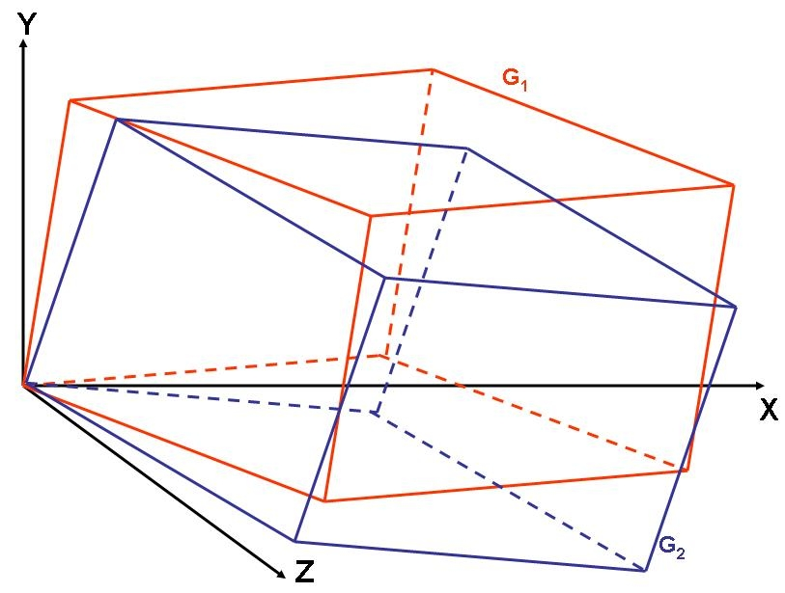
Two gamut

Slide 14
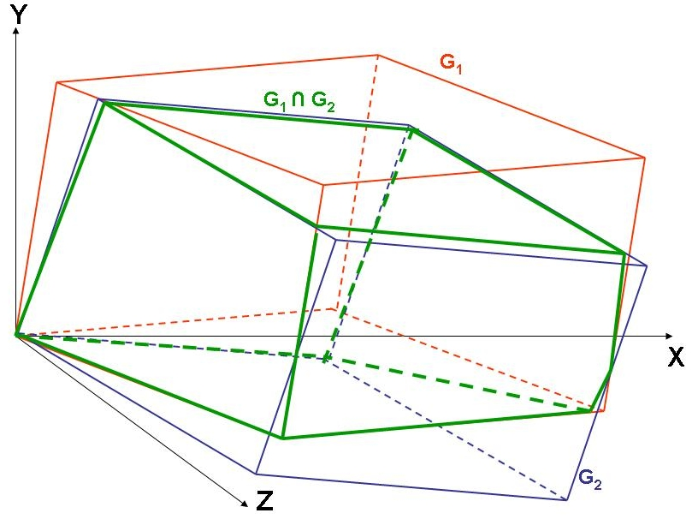
Find their intersection
Need not be a parallelopipped

Slide 15
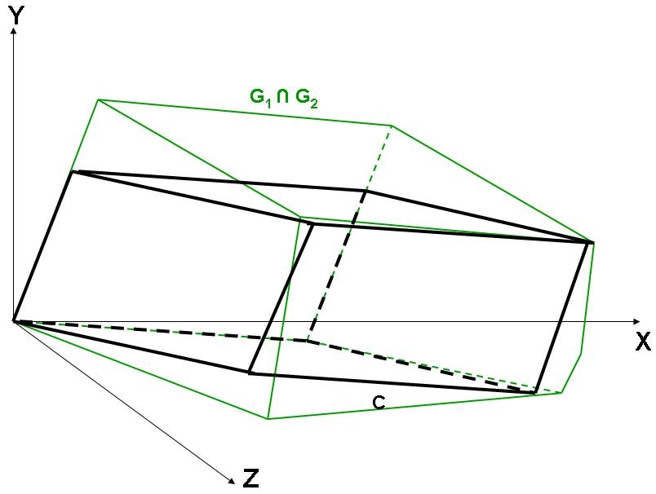
Find the common gamut

Slide 16
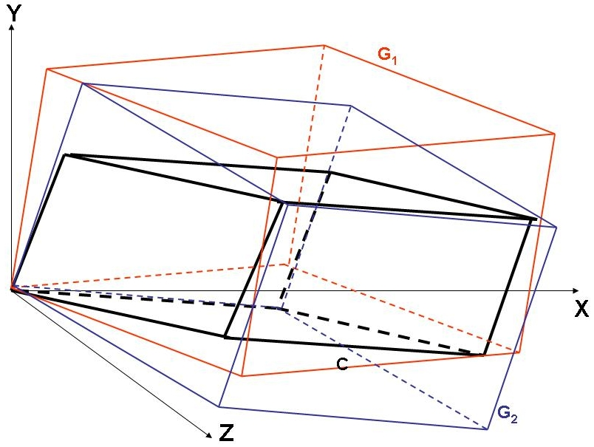
Find the mapping function

Slide 17
Gamut Mapping
Changing the actual colors
Mapping color in one gamut to another in the new gamut
If just dealing with two devices, may choose to move colors from one gamut to another

Slide 18
What is gamma function?
( X_{g} ,Y_{g},Z_{g} )
( X_{r} ,Y_{r} ,Z_{r} )
X = X_{r} X_{g} X_{b} h _{r} ( i _{r} )
( X_{b} ,Y_{b} ,Z_{b} )
Y = Y_{r} Y_{g} Y_{b} h _{g} ( i _{g} )
Z = Z_{r} Z_{g} Z_{b} h _{b} ( i _{b} )

Slide 19
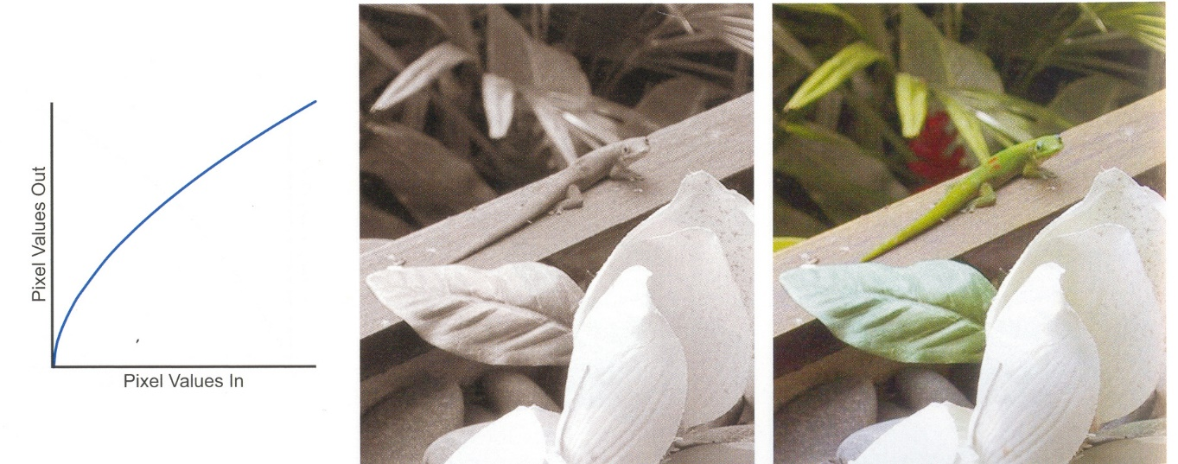
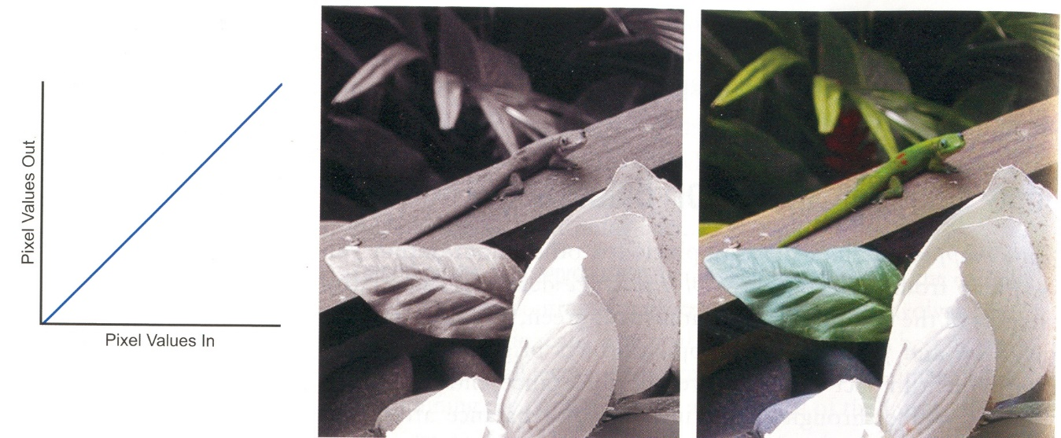
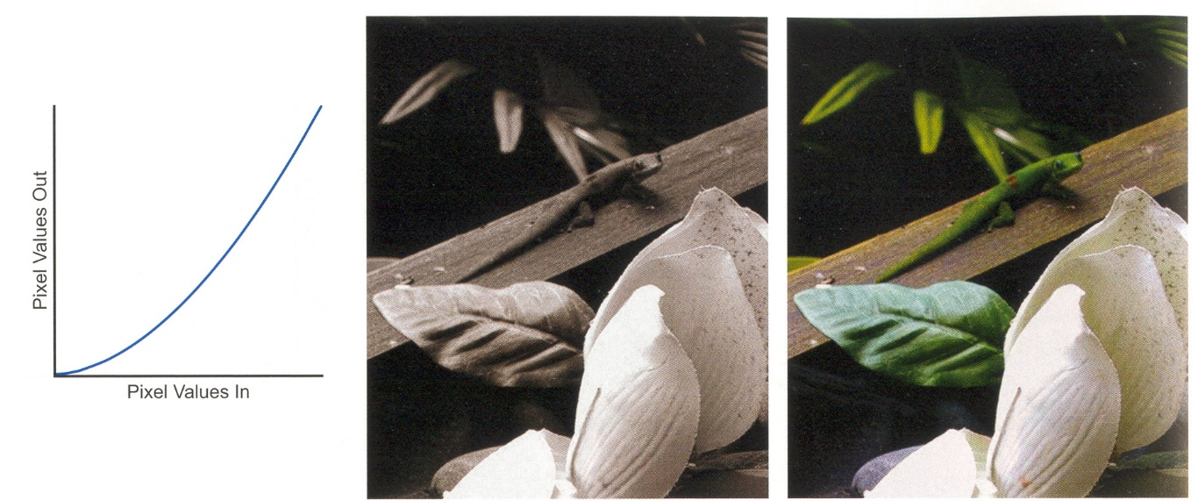
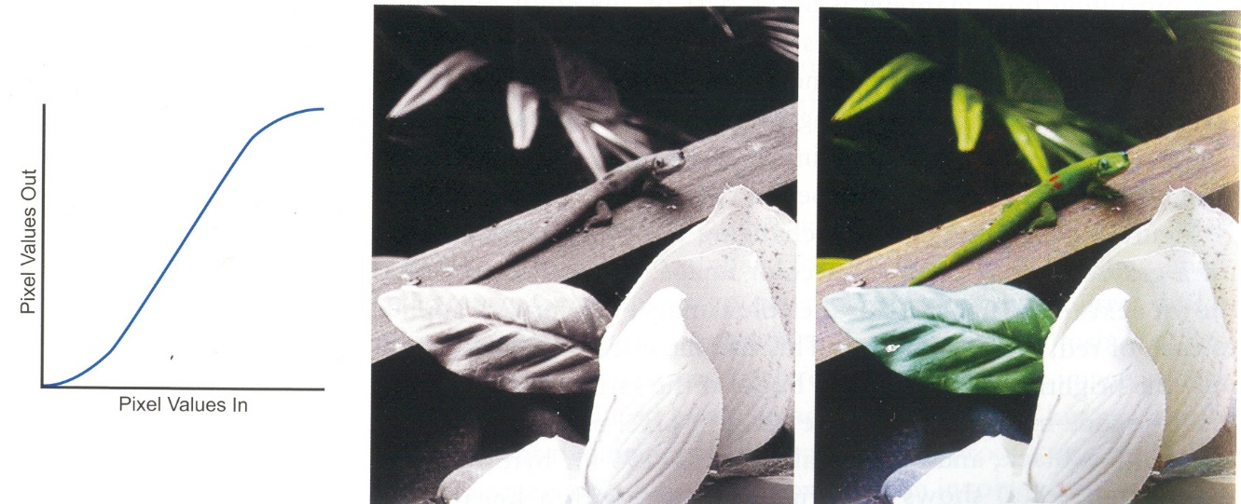
Tone Mapping Operator
How the input value maps to output intensity
Affects brightness, contrast and saturation

Slide 20
Transfer Function
Monotonic, smooth with no flat regions
Brightness and contrast controls

Slide 21
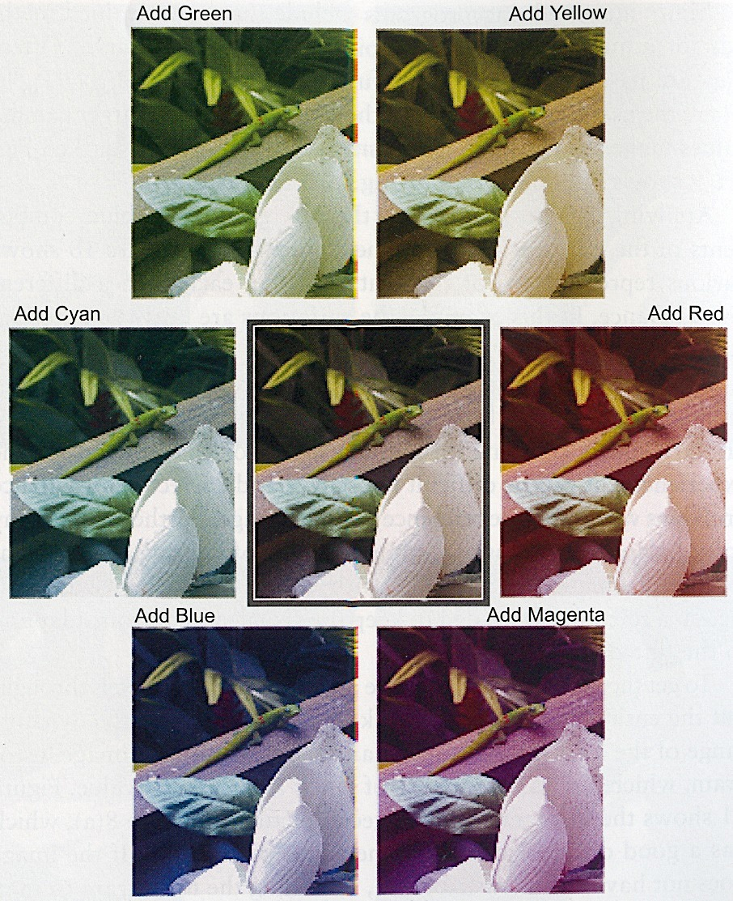
Color Balance
Relative proportions of primaries while forming a color
Affects hue, saturation and brightness
Can be changed by changing the transfer function

Slide 22
Subtractive Color
Subtractive like paint
Cannot be modeled by CIE XYZ space
C₁(λ)
C₂(λ)
Power
Wavelength

Slide 23
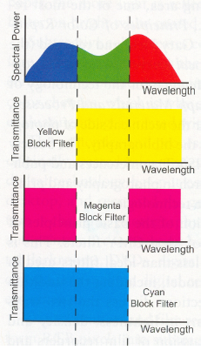
Subtractive Color System
Layers of cyan, yellow and magenta dyes
Absorb red, blue and green light
Depends on the illuminant
Act as absorption filter
Ideally block filters
Overlaying all the three dyes absorbs all wavelengths creating black

Slide 24
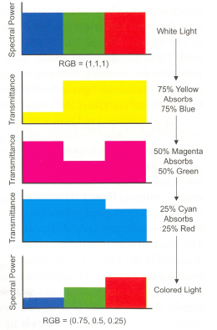
Creation of a color
CMY = (1, 1, 1) – RGB
(0.25, 0.5, 0.75) = (1, 1, 1) – (0.75, 0.5, 0.25)
This works only for block filters

Slide 25
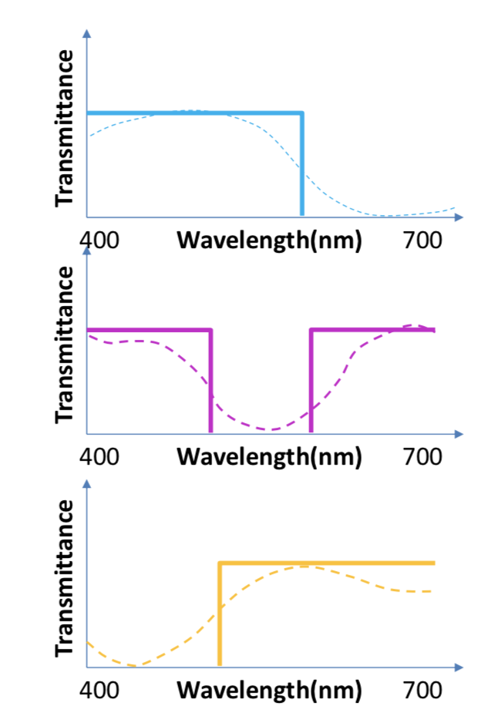
Real Filters
Are not block filters
Cross talk across different filters
Due to ink impurities
Grays should be formed by equal amount of three primaries
Seldom happens

