Slide 1
CS 112 – Display Considerations

Slide 2
Display
Image generation
Generate digital images
Should take care to have non-aliased images
Image Reconstruction
Generate a continuous image on the display

Slide 3
Image Reconstruction
Each pixel is not a point but an area
How is that area lighted?
Spot Width
2D
1D
Wider spots
Narrower spots
In practice
Ideal Case

Slide 4
Aliasing artifacts (Right Width)

Slide 5
Wider Spots (Lost high frequencies)

Slide 6
Narrow Width (Jaggies, insufficient sampling)

Slide 7
Quantization
Digitization of color
Gray scale – infinite grays between 0 and 1
8 bit representation – 256 levels
A range of grays represented by a single value
Any value is assigned to one of k values
Choose number of levels and range of each level

Slide 8
Quantization Error
Uniform Quantization
Maximum Error = ½ Step Size
Q(g)
Quantization Error
Step Size
g

Slide 9
Human Perception
Use properties of human perception
Response Compression
Response Expansion

Slide 10
Steven’s Power Law
P = KS ^{n}
P = Perception
S = Stimulus
Strength
n>1.0 (Expansion)
n<1.0 (Compression)

Slide 11
Steven’s Power Law
P = KS ^{n}
P = Perception
S = Stimulus
Strength
n>1.0 (Expansion)
n<1.0 (Compression)

Slide 12
Gamma Function
Inverse of human response curve for faithful representation of intensities
Called the gamma function
O = I^{γ}
Gamma Correction
Human Response
Output Intensity
Display Gamma
Input Intensity

Slide 13
Non-Uniform Quantization
Note how quantization changes
Non-uniform step size
Maximum Error
½ of maximum step size
# of levels is the color resolution
# of bits
Display Gamma
Output Intensity
Input Intensity

Slide 14
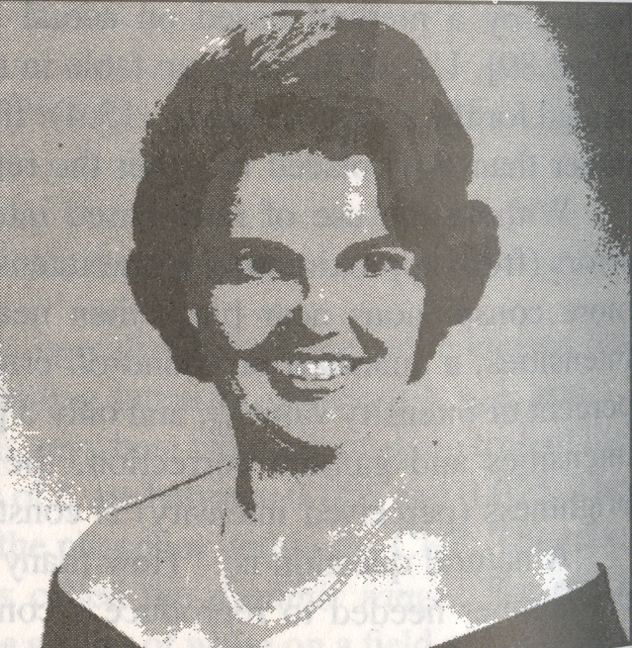
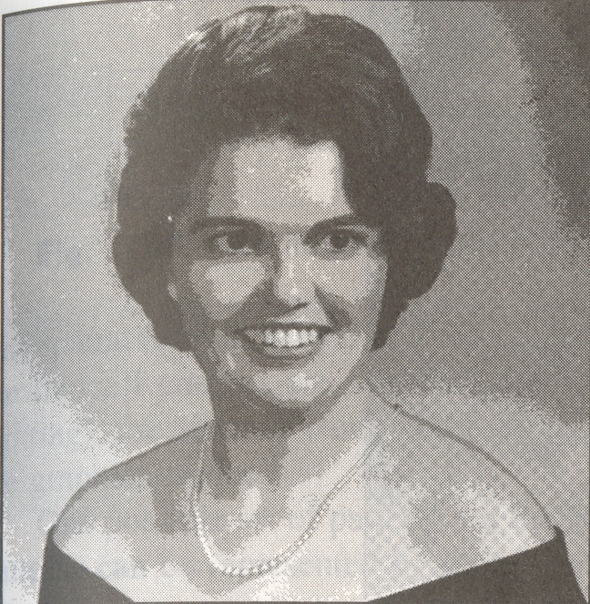
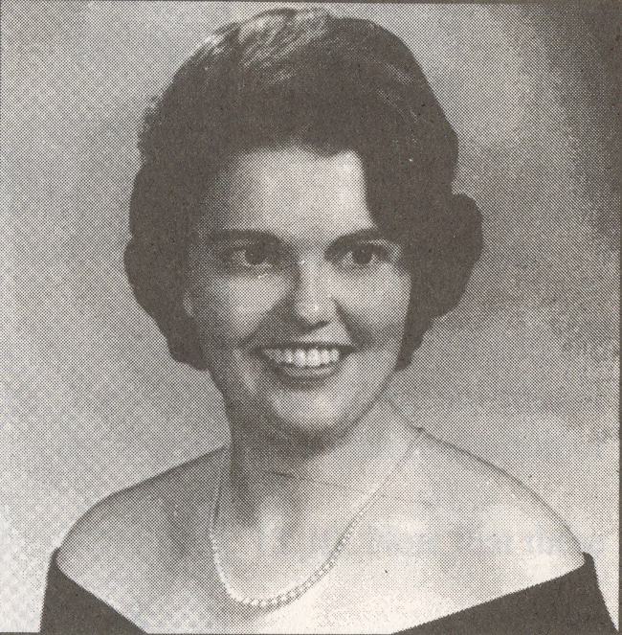
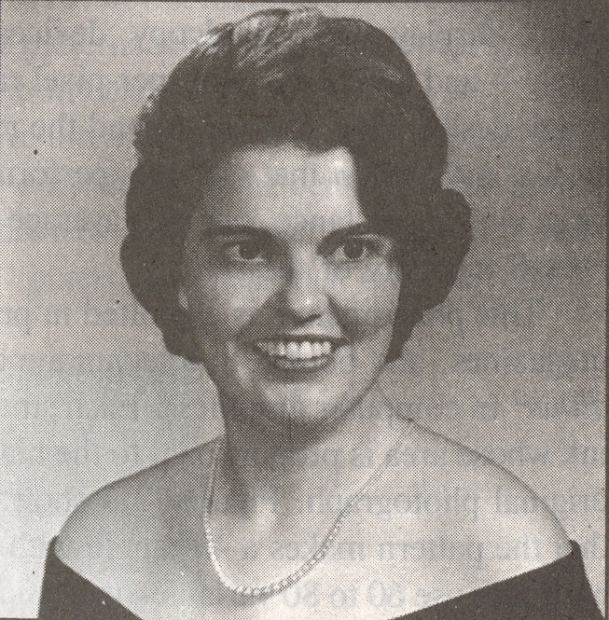
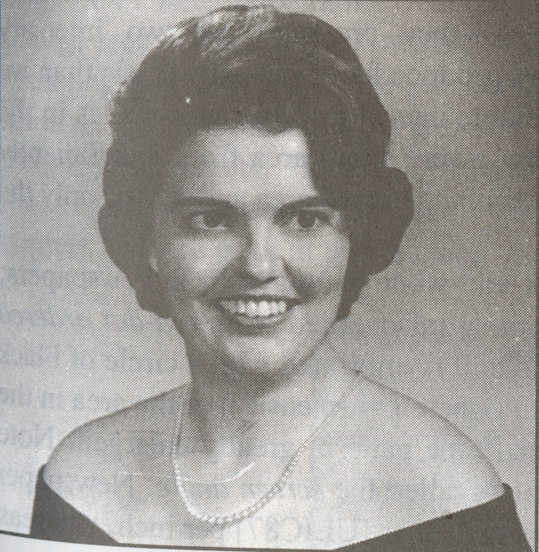
Color Resolution
Analog Image
4 Steps
8 Steps
16 Steps
Quantization Artifacts
64 Steps
32 Steps

Slide 15
Dithering
What if the color resolution is low?
Newsprint – Bi-level, only black and white
Can we expand the # of colors?
Spatial integration of eye
Trading off spatial resolution for intensity resolution

Slide 16
Dithering
0 2
Represented by a dither matrix
nxn pixels, bi-level intensity, can produce n²+1 intensities
If more than two levels – k levels
n². (k-1) +1
Used for increasing the color resolution
1 3

Slide 17
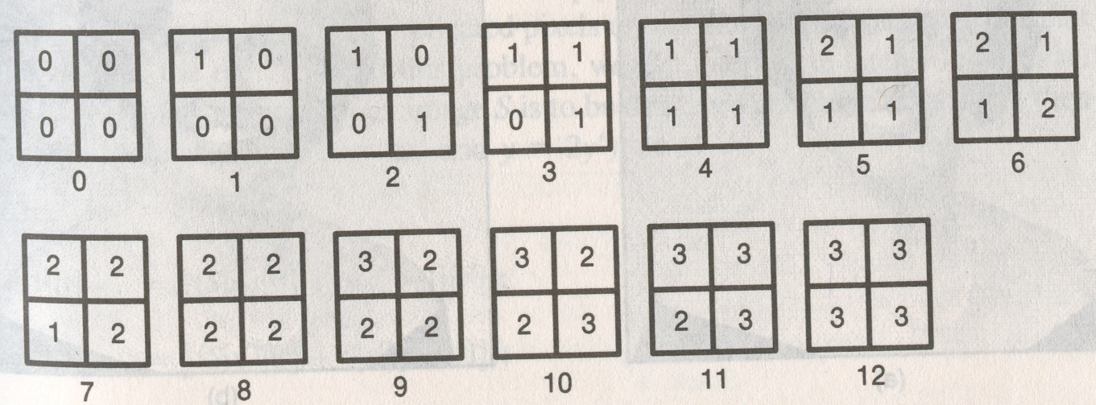
Dithering
If more than two levels – k levels
n². (k-1) +1
For k = 4 (0,1,2,3) and n=2

Slide 18
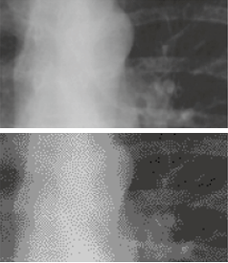
Examples
Loss of tone and details
(Intensity and Spatial Resolution)

