Slide 1
CS 112 - Ray Tracing

Slide 2
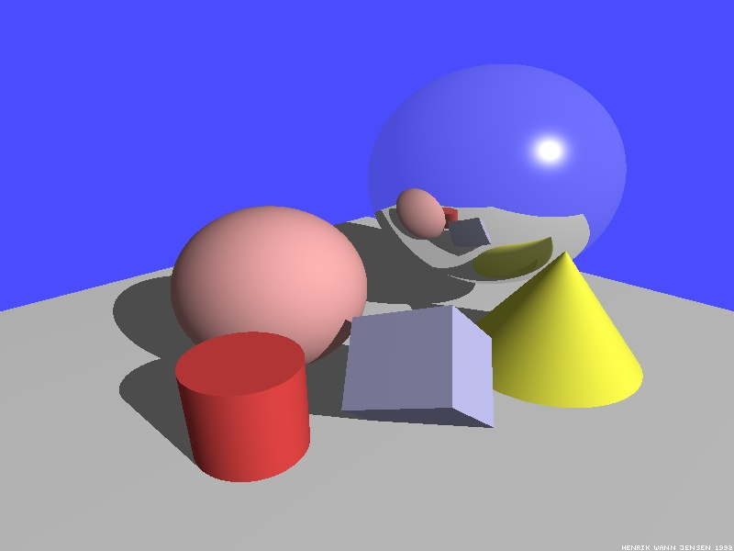
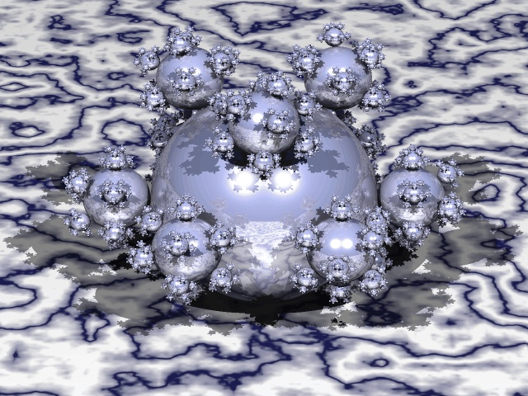
Illumination is not accurate
Cannot capture the effects of refraction, transparency and translucency accurately.

Slide 3
Direct and Indirect Illumination
Capture only direct illumination
Light coming directly from light
Light bounces from other objects in the scene

Slide 4
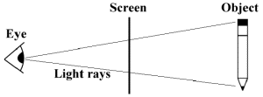
Ray Tracing
Reflected ray
Start from the light and find how each ray is getting reflected to from different objects to reach the viewer
Exponentially complex problem
Reverse operation
Start from the viewer and see how a particular ray has traveled
Refracted ray

Slide 5
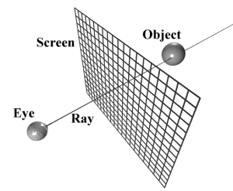
Ray Tracing
Casts one ray per pixel
Casts a bunch of ray in the scene
Find out how the ray traverses

Slide 6
Recursive Ray Tracing
Ray hits an object at P
Cast a shadow ray S from P to each light
If shadow ray does not intersect any other object, calculate direct illumination from light I_{L}
Cast a reflected ray R from P and find its contribution, I_{R}
Cast a refracted ray T from P and find its contribution, I_{T}
C = w_{L}I_{L}+w_{R}I_{R}+w_{T}I_{T}

Slide 7
How to stop the recursion?
If a ray has travelled beyond
A threshold distance
A threshold number of hops
Energy is the ray has fallen beyond a certain threshold

Slide 8
Intersections (Ray-Sphere)
|P-P_{c}|² – r² = 0
P = P₀ + t(P₁-P₀)
|P₀-P_{c} + t(P₁-P₀)|² – r² = 0
Will give you a quadratic equation to solve for t
P₀
P₁
P
r
P_{c}

Slide 9
Ray-Triangle Intersection
V₀, V₁, V₂ – Triangle
V₀ + u(V₁-V₀) + v(V₂-V₀)
P₀, P₁ - Ray
P₀ + t(P₁-P₀)
Intersection point I, such that
V₀ + u(V₁-V₀) + v(V₂-V₀) = P₀ + t(P₁-P₀)
u(V₁-V₀) + v(V₂-V₀) + t(P₀-P₁) = P₀-V₀
uA + vB + tC = D
3D vectors

Slide 10
Ray Triangle Intersection
A_{x} B_{x} C_{x}
u
D_{x}
A_{y} B_{y} C_{y}
v
D_{y}
t
=
D_{z}
A_{z} B_{z} C_{z}
-1
u
A_{x} B_{x} C_{x}
D_{x}
v
A_{y} B_{y} C_{y}
D_{y}
t
=
D_{z}
A_{z} B_{z} C_{z}

Slide 11
Antialiasing
Shoot more than one ray through the pixels
Super-sampling
Average their contribution
Filtering

