Slide 1
CS112:
Object Representation
Aditi Majumder
Professor of Computer Science
University of California, Irvine

Slide 2
Representing Object Shapes
Goal: expressing the shape of an object mathematically
Some Representations
  Explicit:
    Can draw the line, but cannot represent the y axis
  Implicit:
    Cannot draw the line, but evaluate if points lie on the line
  Parametric:
    Essentially interpolating P₁ and P₂

Slide 3
Polygonal Maeshes
Approximate surface geometries with collections of polygonal (mostly triangular) faces
Geometric information
  Vertex: positions, normal directions, …
Topological information
  Connectivity or Adjacency
Other per-vertex attributes
  Color, texture coordinates, …

Slide 4
Polygonal Maeshes

Slide 5
Assumptions
In this course, we assume the meshes to be 2D (orientable) manifolds
  Every edge has at most two incident triangles
  No self-intersections
Manifold
Non-manifold

Slide 6
Why Triangles?
Consistently planar
Easy definition of topology and geometry
Easy to implement in hardware

Slide 7
Interpolation
Linear interpolation
P1
L(u)
P2
P2
u
Bilinear interpolation
T(u,v)
P1
v
P3
Linear combination of the points
Coefficients
  Positive and sum to less than 1.0: within the convex hull
  Otherwise: outside the convex hull

Slide 8
Rotationally Invariant Interpolation
W
B
W
B
B
W
W
B

Slide 9
Common Data Structure
List of vertices
List of faces (i.e., triangles)
  Defined by indices of vertices

Slide 10
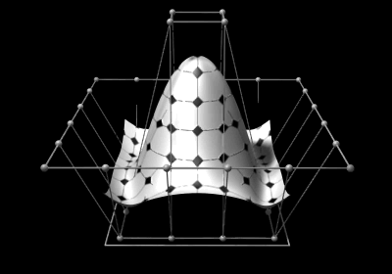
Other Surface Representations
Splines
  Have to be converted to polygons for rasterization
Volumetric models
Point (particle) clouds

Slide 11
Volumetric Representations
3D volumes comprised of voxels

Slide 12
Volumetric Representations
3D volumes comprised of voxels

Slide 13
Particle (Point) Representation
Large collections of points

Slide 14
CS112: Interactive
Rendering Pipeline

Slide 15
Interactive Rendering Pipeline
Input: fully described 3D scenes
  Object geometry, shading, illumination, etc.
Output: rendered images
  representing what a virtual camera sees
Standard interactive rendering pipeline:
  Model-view transformation
  Projection transformation
  Clipping and Vertex Interpolation of Attributes
  Rasterization and Pixel Interpolation of Attributes

Slide 16
Model-View Transformation
Model transformation
View transformation
Coordinate systems:
  World
  Object

Slide 17
World and Object Coordinates
Y_{O}
Y_{W}
X_{O}
X_{W}
Z_{O}
Y_{O}
Z_{W}
Y_{O}
X_{O}
MODEL TRANSFORMATION
X_{O}
Z_{O}
Z_{O}

Slide 18
Model Transformation
Transforming from the object to world coordinates
  Placing the object in the desired position, scale and orientation
In theory, can involve any kind of transformations
In practice, involves affine transformations like translation, rotation, scaling, and shearing
  More on these in the following lectures

Slide 19
View Transformation
Y_{W}
X_{W}
Z_{W}

Slide 20
View Transformation
Position and orientation of eye (9 parameters)
  View point
    POINT: (x, y, z) [3]
  Normal to the image plane
    VECTOR: (v_{x}, v_{y}, v_{z}) [3]
  View Up
    VECTOR: (u_{x}, u_{y}, u_{z}) [3]
  Default: (0,0,0), (0,0,-1), (0,1,0)
View transformation to align
  Eye with the origin
  Normal to the image plane with negative Z axis
  View Up vector with positive Y axis
  Can be achieved by rotation and translation

Slide 21
Interactive Rendering Pipeline
Input: fully described 3D scenes
  Object geometry, shading, illumination, etc.
Output: rendered images
  representing what a virtual camera sees
Standard interactive rendering pipeline:
  Model-view transformation
  Projection transformation
  Clipping and Vertex Interpolation of Attributes
  Rasterization and Pixel Interpolation of Attributes

Slide 22
Projection Transformation
Define the “view frustum” (6 parameters)
  Assume origin is the view point
  Near and far planes (planes parallel to XY plane in the negative Z axis) [2]
  Left, right, top, bottom rectangle defined on the near plane [4]
-Z
Y
X
near
far

Slide 23
Projection Transformation
Transforming the view frustum (along with the objects inside it) into a
  cuboid with unit square faces on the near and far planes
  the negative Z axis passes through the center of these two faces.
  Projecting the objects on the near plane
Consists of a “shear” and a “perspective projection” operations.

Slide 24
Projection Transformation
Y
X
Z

Slide 25
Remark
Every vertex undergoes the model-view and projection transformations
These transformations are geometric
  Topology does not change

Slide 26
Interactive Rendering Pipeline
Input: fully described 3D scenes
  Object geometry, shading, illumination, etc.
Output: rendered images
  representing what a virtual camera sees
Standard interactive rendering pipeline:
  Model-view transformation
  Projection transformation
  Clipping and Vertex Interpolation of Attributes
  Rasterization and Pixel Interpolation of Attributes

Slide 27
Clipping
Removing the part of the polygon outside the view frustum
If the polygon spans inside and outside the view frustum
  introduce new vertices on the boundary

Slide 28
Interpolation of Attributes
For the new vertices introduced
  compute all the attributes
  Using interpolation of the attributes of all the original vertices

Slide 29
Interpolation of Attributes
For the new vertices introduced
  compute all the attributes
  Using interpolation of the attributes of all the original vertices

Slide 30
Window Coordinate Transformation
Scale XY coordinates of unit cuboid to reflect size of window (relative pixel coordinates)
Translate these coordinates to the position of the window on the monitor screen to represent the absolute pixel coordinates.
Z value is used for resolving occlusion

Slide 31
Interactive Rendering Pipeline
Input: fully described 3D scenes
  Object geometry, shading, illumination, etc.
Output: rendered images
  representing what a virtual camera sees
Standard interactive rendering pipeline:
  Model-view transformation
  Projection transformation
  Clipping and Vertex Interpolation of Attributes
  Rasterization and Pixel Interpolation of Attributes

Slide 32
Rasterization
Process of generating pixels in the scan (horizontal) line order (top to bottom, left to right).
  Which pixels are in the polygon
Scan Line
left
left
right
right

Slide 33
Interpolation of Attributes
Interpolate the colors and other attributes at pixels from the attributes of the left and right extent of the scan line on the polygon edge.
Also in scan line order
Scan Line
left
left
right
right

Slide 34
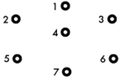
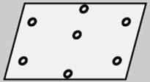
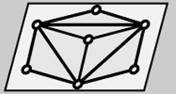

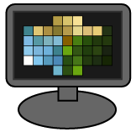
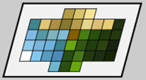
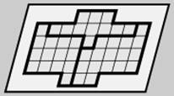
OpenGL Rendering Pipeline
{1, 2, 3}, {3, 2, 4},
{4, 2, 7}, {7, 2, 5},
…
Model-view &
projection
transformations
Element array
Vertex
Shader
Triangle
assembly
Input
Vertex array
Rasterization
Uniform state
Testing &
blending
Fragment
Shader
Output
Framebuffer
[http://duriansoftware.com/joe]

