Slide 1
CS112:
Transformation I

Slide 2
Points and Vectors
Points
  Represent locations
Vectors
  Represent displacements
  Defined with two points P and Q:
  Magnitude
  Direction (unit vector)
Remark: points and vectors share identical representations (i.e., 3D arrays) but are different mathematical concepts
CS112:
Transformations I
P
v
Q
Shuang Zhao
Assistant Professor of Computer Science
University of California, Irvine

Slide 3
Vector Operations
Given vectors u = (u_{x}, u_{y}, u_{z}) and v = (v_{x}, v_{y}, v_{z})
Addition, subtraction
  u + v = (u_{x} + v_{x}, u_{y} + v_{y}, u_{z} + v_{z})
  u - v = (u_{x} - v_{x}, u_{y} - v_{y}, u_{z} - v_{z})
Scaling
  au = (a u_{x}, a u_{y}, a u_{z})
  Direction does not change
Linear dependency
  A set of vectors v₁, v₂, …, v_{n} is linearly dependent if
  a₁v₁ + a₂v₂ + … + a_{n}v_{n} = 0 has nonzero solutions
v
u+v
2u
u
-v
u-v

Slide 4
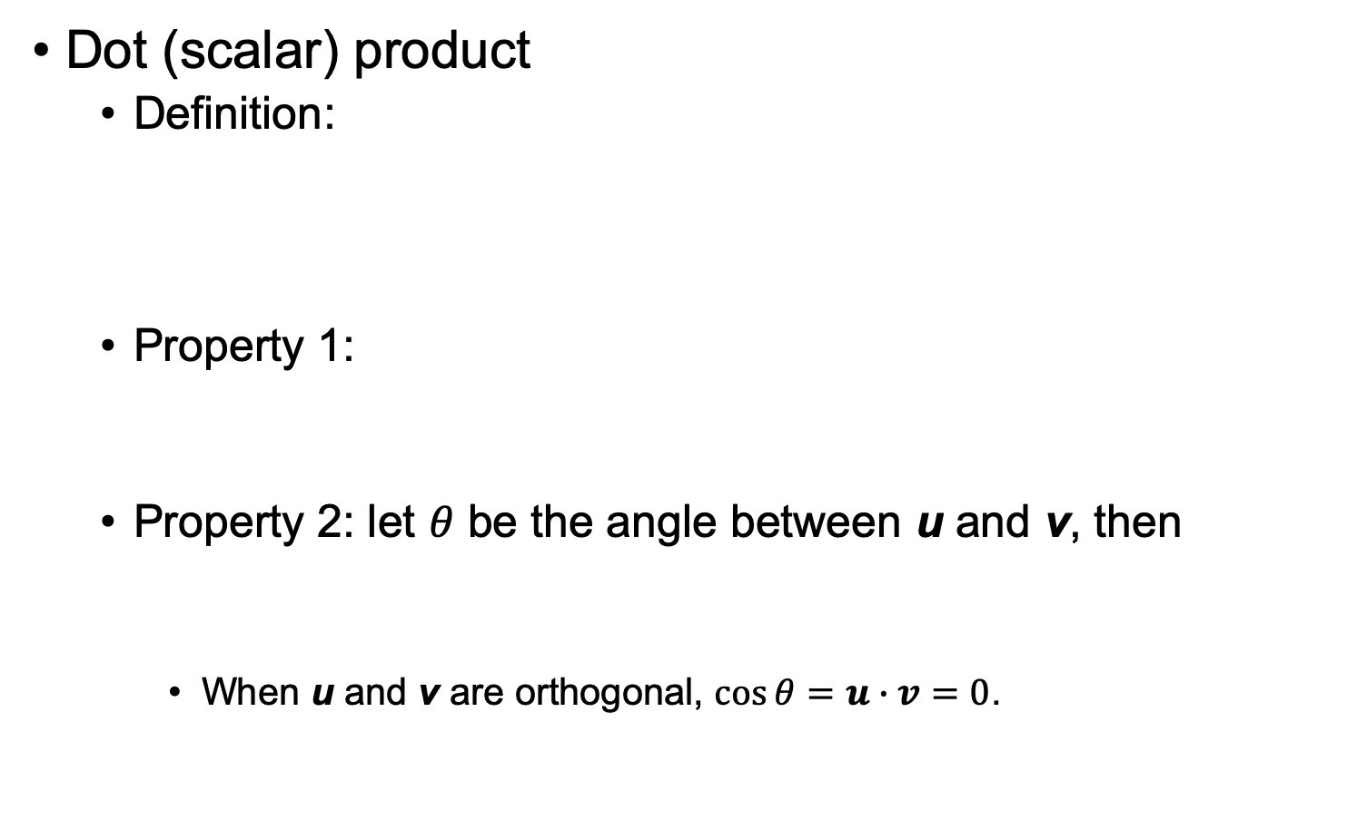
Vector Operations
Dot (scalar) product
  Definition:
  Property 1:
  Property 2: let $θ$ be the angle between u and v, then
    When u and v are orthogonal, $\cos{θ}=u∙v=0$.

Slide 5
Vector Operations
Cross (vector) product
  Definition:
  Property 1: orthogonal of plane of u and v
  Property 2:
    Hence, n is zero for parallel vectors
Remark
  The dot product of two vectors is a
  scalar (i.e., number)
  The cross product is a vector
n
v
u

Slide 6
Lines
Defined by a point P and a vector (Q - P)
  Parametric expression:
  L(α) = P + α(Q - P) = αQ + (1 - α)P
Essentially linear interpolations of P and
Q with (continuously) varying weights
A line is an affine sum of two points
  Points defined by affine sum lie on the
  line between the two points
α > 1
Q
α = 1
P
α = 0
α < 0

Slide 7
Convexity
Generalized for n points
  L(α₁,…, α_{n}) = α₁P₁ + α₂P₂ + … + α_{n}P_{n}
  When α₁ + α₂ + …. α_{n} = 1 and 0 ≤ α_{i} ≤ 1,
  L is guaranteed to lie in the convex hull
  of the points P₁, P₂,…, P_{n}

Slide 8
Planes
Three non-collinear points P, Q, and R define a plane
S(α) = αP + (1 - α)Q
T(α,β) = βS(α) + (1 - β)R
= αβP + β(1 - α)Q + (1 - β)R
= P + β(1 - α)(Q - P) + (1 - β)(R - P)
Plane normal:
  Satisfies
R
T(α,β)
P
S(α)
Q

Slide 9
Linear Transformation
Transformation
  Defined by a function that maps a point (vector) to another point (vector): q = T(p)
  Transforming a line (surface) means transforming individual points on the line (surface)
Linear transformation
  A transformation T satisfying T(ap + bq) = aT(p) + bT(q)
  The ordering of linear transformation and linear combination can be exchanged:
    T(ap + bq): linear combination first, then transformation
    aT(p) + bT(q): linear transformation first, then combination

Slide 10
Linear Transformation
All linear transformations can be represented using matrix multiplications
Given a point P = (P_{x}, P_{y}, P_{z}), any linear transformation of P can be expressed as

Slide 11
Linear Transformation Properties
Preservation of zero points
  Since T(0) = T(0 + 0) = T(0) + T(0), we have T(0) = 0
Preservation of straight lines
  Any point on a straight line determined by points P and Q can be expressed as (aP + bQ)
  Since T(aP + bQ) = aT(P) + bT(Q), we know that the linearly transformed point is on another straight line determined by points T(P) and T(Q)

Slide 12
Linear Transformation Properties
Preservation of parallel lines
  That is, sets of parallel lines remain parallel after a linear transformation
Does not necessarily preserve angles
Common linear transformations:
  Scaling
  Rotation
  Shear

Slide 13
(Axis-Aligned) Scaling
P’ can be obtained by left-multiplying a diagonal matrix S(S_{x}, S_{y}, S_{z}) to P:
S⁻¹(S_{x}, S_{y}, S_{z}) = S(1/S_{x}, 1/S_{y}, 1/S_{z})

Slide 14
Rotation in 2D
(x’, y’)
(x, y)
θ
ρ
φ

Slide 15
Rotation in 3D
Around the Z axis:
Around the X axis:
Arbitrary 3D rotations can be expressed with
R_{x}(θ_{x}) R_{y}(θ_{y}) R_{z}(θ_{z}) (where θ_{x}, θ_{y}, θ_{z} are called Euler angles)
R(θ)

Slide 16
Shear in 2D
Translate one coordinate of a point proportionally to the value of the other coordinate of the same point
A point (x, y) in 2D is mapped to:
  x-shear: (x, y + bx)
  y-share: (x + ay, y)
Properties:
  Changes the shape of the object
  Generally do not preserve angles

Slide 17
Shear in 3D
Translate all but one coordinate of a point proportionally to the value of that one coordinate
Example: z-shear
  A point (x, y, z) in 3D is mapped to (x + az, y + bz, z)

Slide 18
Linear Transformation Properties
Is translation linear?
  No, since it does not preserve zero points
Translation is an affine transformation

Slide 19
Affine Transformation
Given by linear transformation + translation:
  q = T(p) + r, where T is linear
Satisfy all but one linear transformation properties
  Zero points are not necessarily preserved
All linear transformations are affine (by setting r = 0). But not all affine transformations are linear.
We now have translation covered!

Slide 20
Affine Transformations
All affine transformations can be represented using matrix multiplications and additions
Given a point P = (P_{x}, P_{y}, P_{z}), any affine transformation of P can be expressed as

Slide 21
Affine Transformations
We can also rewrite the operations as pure matrix-vector multiplication by adding one extra dimension:
Homogeneous
coordinate

Slide 22
Homogeneous Coordinates
Y
Note: (x/y, 1), (x, y), and (2x, 2y) represent the same 1D point P’
Q = (2x,2y)
Any point on the same vector has the same homogeneous coordinates
P = (x,y)
x/y
1D points on the line is represented by 2D arrays, called homogeneous coordinates
P’ = (x/y,1)
y=1
X

Slide 23
Generalizing to Higher Dimensions
Z
2D points represented by 3D homogeneous coordinates
P = (x, y, z)
P’ = (x/z, y/z, 1)
Similarly, 3D points are represented by 4D homogeneous coordinates
X
If (x, y, z, w) is the homogeneous coordinate of a 3D point, then the 3D point is given by (x/w, y/w, z/w)
Y

Slide 24
Homogeneous Coordinates
4D arrays for describing 3D points and vectors
3D point P = (P_{x}, P_{y}, P_{z}) becomes
3D vector v = (v_{x}, v_{y}, v_{z}) becomes

Slide 25
Affine Transformations in Homogeneous Coord.
Translation:
Scaling:
S(s_{x}, s_{y}, s_{z})

Slide 26
Affine Transformations in Homogeneous Coord.
R_{z}(θ)
Rotation around Z:
Z-shear:

Slide 27
Coordinate System
Represent a 3D point P as a linear combination of three basis vectors v₁, v₂, v₃ and the origin r
  Basis vectors are linearly independent and are usually picked so that they are mutually orthogonal
v₂
P
A matrix
α₂
v₁
α₁
α₃
v₃

Slide 28
Coordinate System
Points
Vectors

Slide 29

Change of Coordinates
Let there be two coord. systems:
  First: v₁, v₂, v₃, R₁; second: u₁, u₂, u₃, R₂
Let P be a point with coord. $\left(α_{1},α_{2},α_{3},1\right)$ under the first system: $P=α_{1}v_{1}+α_{2}v_{2}+α_{3}v_{3}+R_{1}$
u₂
v₂
What is the coord. of P
under the second system?
u₁
P
R₂
v₁
R₁
v₃
u₃

Slide 30
Change of Coordinates
We first represent the basis vectors and the origin of the first coordinate system using the second:

Slide 31
Change of Coordinates
Then,
Thus, P has coordinate under the second system

