Slide 1
CS112: Projection Transformations
Shuang Zhao
Assistant Professor of Computer Science
University of California, Irvine

Slide 2
Default OpenGL View
Usually termed the camera/eye coordinates
Eye at the origin
Image plane perpendicular to -Z
i.e., Eye is “looking at” -Z
View up vector coincident with Y
Y
(View Up Vector)
Image plane
Eye
(Normal to the image plane)
-Z
X

Slide 3
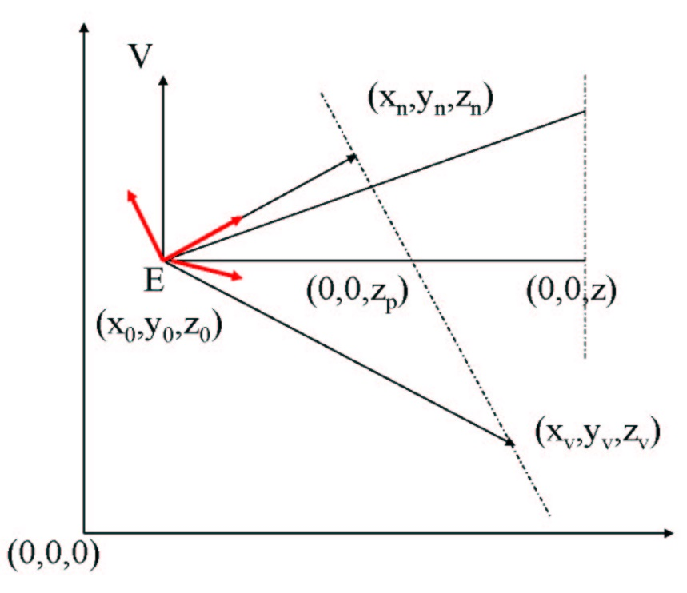
View Transformation
Under the world coordinate:
Eye at point E = (x₀, y₀, z₀)
Need not be (0,0,0)
“Look at” vector N = (x_{n}, y_{n}, z_{n}) - E
Defines normal to the image plane
Need not be the Z axis
“View up” vector V
Defines orientation of the view
Need not be the Y axis
We assume V to be perpendicular to N, but this will be relaxed later
How to transform from world to camera/eye coordinates?
V
V
N
N

Slide 4
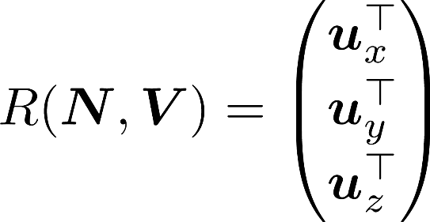
View Transformation
World coordinate:
Origin: E = (x₀, y₀, z₀)
“Look at”: N
“View up”: V
Camera coordinate:
Origin: (0, 0, 0)
“Look at”: (0, 0, -1)
“View up”: (0, 1, 0)
Transforming from world to camera coordinates can be achieved via P_{m} = R(N, V) T(-E) where:
T(-E) is translates E to (0, 0, 0)
R(N, V) rotates N/|N| to (0, 0, -1) and V/|V| to (0, 1, 0)
u_{x}^{T}
u_{y}^{T}
u_{z}^{T}

Slide 5
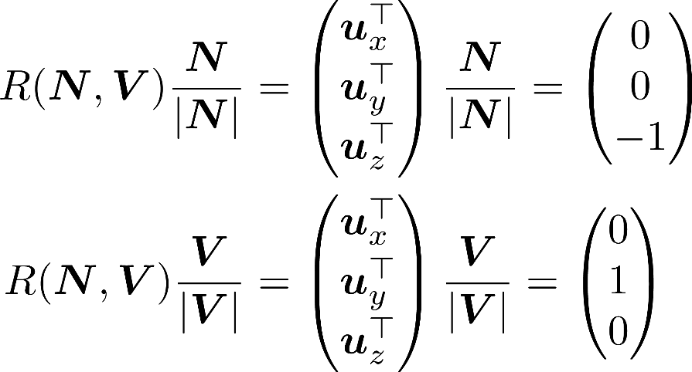
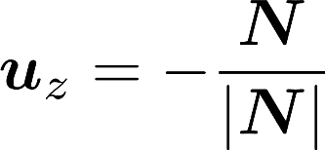
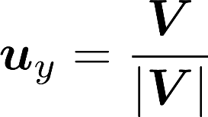
View Transformation
R(N, V) rotates N/|N| to (0, 0, -1) and V/|V| to (0, 1, 0)
Boils down to finding an orthonormal basis u_{x}, u_{y}, and u_{z}:
u_{x}^{T}
u_{y}^{T}
u_{z}^{T}

Slide 6
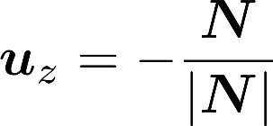
View Transformation
What if N and V are not perpendicular?
There does not exist a rotation R that simultaneously aligns the “look at” direction N/|N| with (0, 0, -1) and the “view up” direction V/|V| with (0, 1, 0)
The alignment of the “look at” direction is usually prioritized by setting u_{z} first:
The other two axes are set afterward:

Slide 7
Perspective Projection
A single viewing point

Slide 8
Perspective Projection
Eye (E): (0, 0 ,0)
“View up” direction: (0, 1, 0)
“Look at” direction: (0, 0, -1)
The image plane is located at z = -n (where n > 0)
View Direction
Mimics eye movement after head is fixed
Tilt-shift lens effect

Slide 9
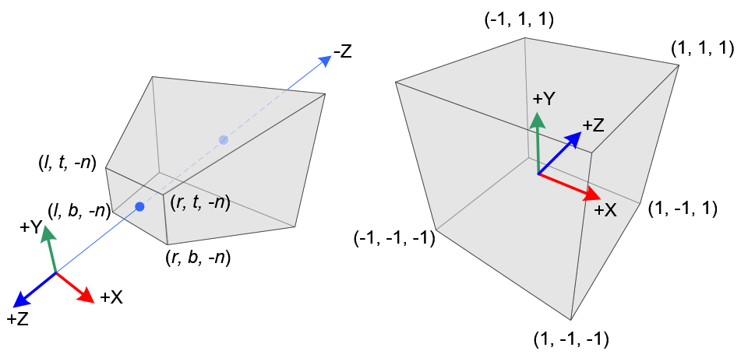
Perspective Projection
The goal of perspective projection is to transform camera/eye coordinates to clip-space coordinates
Camera/eye space (right-handed)
Clip space (left-handed)

Slide 10
The Frustum in the Camera Space
In the camera space:
Eye: (0, 0, 0); “View up”: +Y; “Look at”: -Z
Image plane:
left <= x <= right
bottom <= y <= top
z = -near
The origin and the image plane defines a pyramid
The truncated version of this pyramid (between z = -near and z = -far) is called the frustum
Note: -Z does not have to go through the center of the image plane

Slide 11
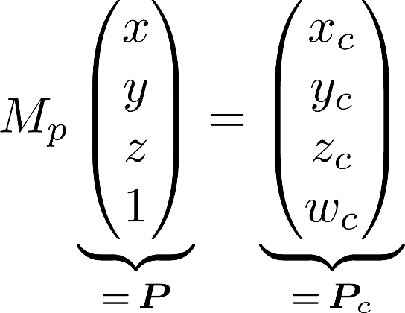
Perspective Projection
The projection matrix M_{p} transforms camera-space (homogeneous) point P to clip-space point P_{c}:
This transformation is NOT affine
E.g., does not preserve parallel lines
We will derive M_{p} in the next few slides

Slide 12
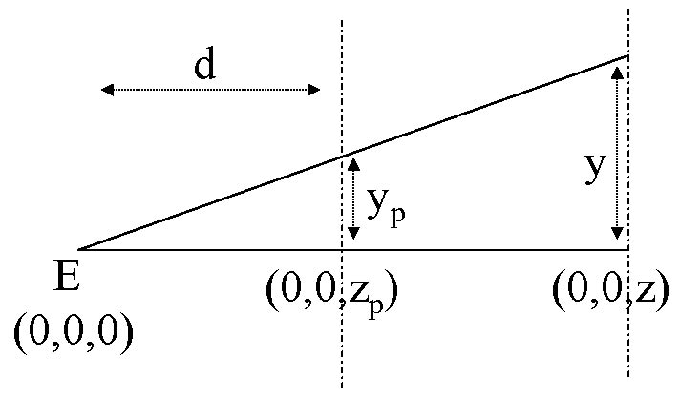
Perspective Projection
P = (x, y, z) projected onto P_{p} = (x_{p}, y_{p}, z_{p}) with z_{p} = -n
Side view
Y
n
n
-Z
z = -n
z = -f

Slide 13
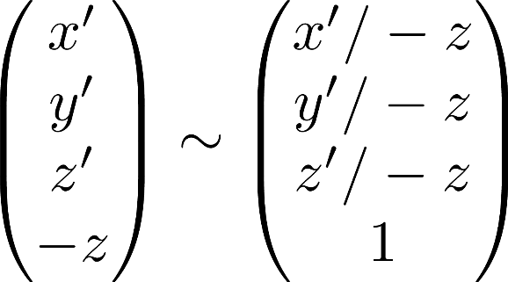
Perspective Projection
Both x_{p} and y_{p} are inversely proportional to -z
How can we achieve this division-by-z using homogeneous coordinates?
Setting the last coordinate to -z:
Thus, it is desired to have the last coordinate w_{c} of the clip-space coordinate to be -z

Slide 14
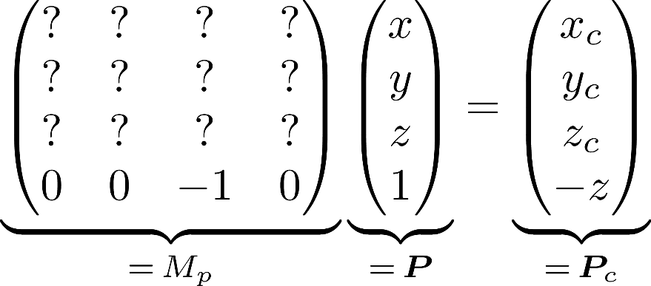
Perspective Projection Matrix
We can achieve this by setting the last row of the projection matrix:
How about the first three rows of M_{p}?
Consider how the corners of the frustum is transformed

Slide 15
Perspective Projection Matrix
Recall: the image plane is given by
left <= x <= right
bottom <= y <= top
z = -near
We want to linearly map:
This can be achieved by setting

Slide 16
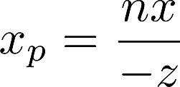
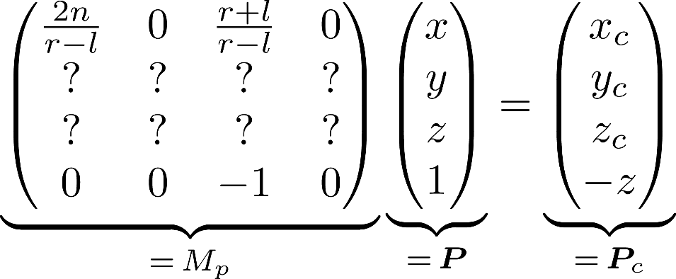
Perspective Projection Matrix
Recall that , we have
This gives us the first row of the projection matrix M_{p}:

Slide 17
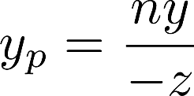
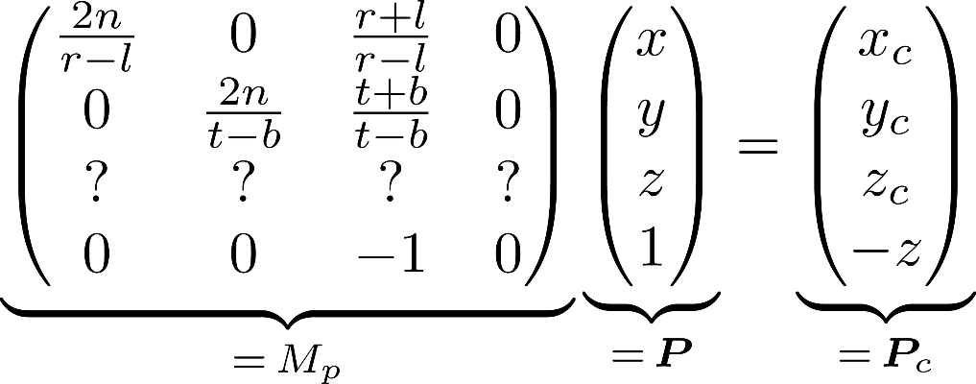
Perspective Projection Matrix
Given , a similar derivation gives
This gives the second row of M_{p}:
One last row to go!

Slide 18
Perspective Projection Matrix
Recall that the projection transformation is supposed to transform (i) z = -n to z = -1; and (ii) z = -f to z = 1
Camera/eye space (right-handed)
Clip space (left-handed)

Slide 19
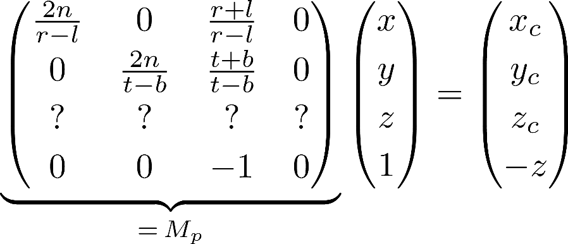
Perspective Projection Matrix
In homogeneous coordinates with w_{c} = -z, we need:
z = -n
z = -f
z = -n/n = -1 (clip space)
z = f/f = 1 (clip space)

Slide 20
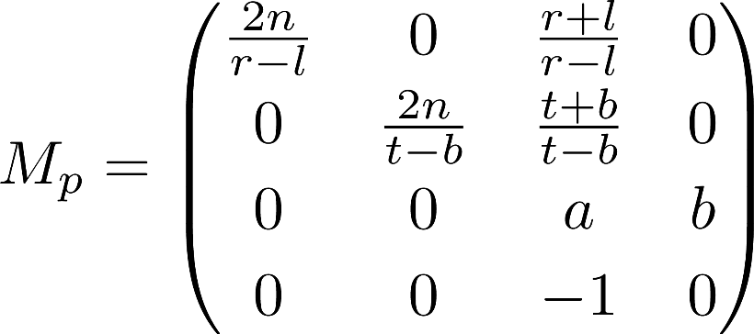
Perspective Projection Matrix
In homogeneous coordinates with w_{c} = -z, we need:
Note that the transformation of z (from [-n, -f] to [-1, 1]) is independent of x and y, we can set

Slide 21
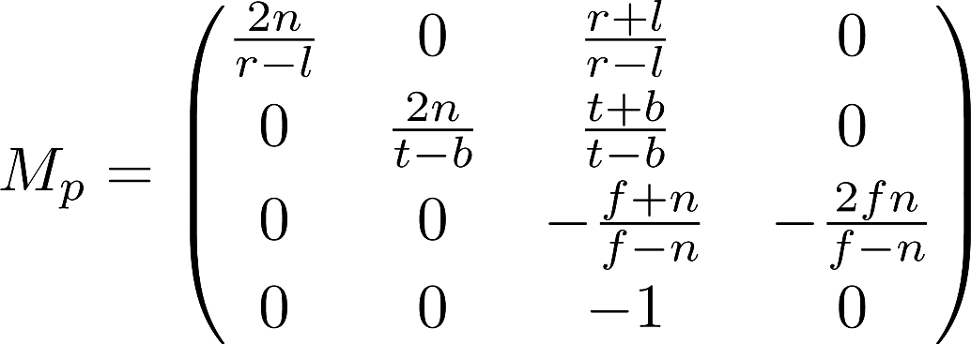
Perspective Projection Matrix
In homogeneous coordinates with w_{c} = -z, we need:
Thus,
The full perspective projection matrix equals:

Slide 22
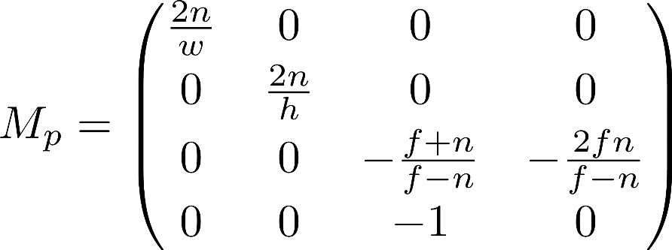
Perspective Projection Matrix
When the frustum is symmetric (i.e., r + l = 0, t + b = 0)
Let r - l = width and t - b = height
Then, the projection matrix simplies to:

Slide 23
From Clip Space to Frame Buffer
All points outside the frustum are ignored
Each point inside clip-space coordinate (x’, y’, z’)
Has its projection on the image plane at (x’, y')
This coordinate can be simply scaled and translated to get the corresponding screen/window coordinate
Multiple 3D points can have identical screen/window coordinates
In other words, when multiple objects occlude each other, their projections on the image plane would overlap
How can we resolve the occlusion
i.e., by deciding which object occludes which?

Slide 24
Screen-Space Occlusion Handling
During rasterization, the depth (i.e., z’ value) of each fragment (i.e., point on a triangle) is used
If fragment depth < frame buffer pixel depth:
The current object occludes the previously drawn one
Overwrite
If fragment depth > frame buffer pixel depth:
The current object is occluded by the previously drawn one
Skip
This handling of depth values is called “depth test” in OpenGL
More complicated behavior with alpha-blending

Slide 25
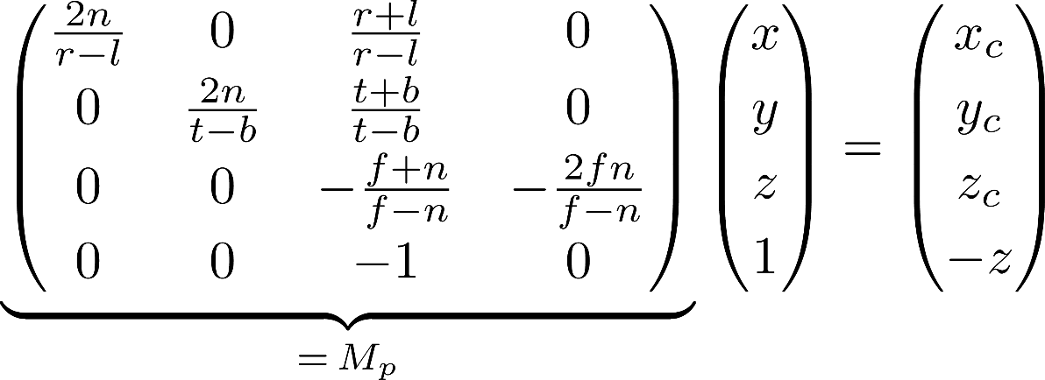
Z-Fighting
The perspective projection transformation maps z ∈ [-n, -f] to z’ ∈ [-1, 1] nonlinearly
It follows that
Linear in 1/z instead of z

Slide 26
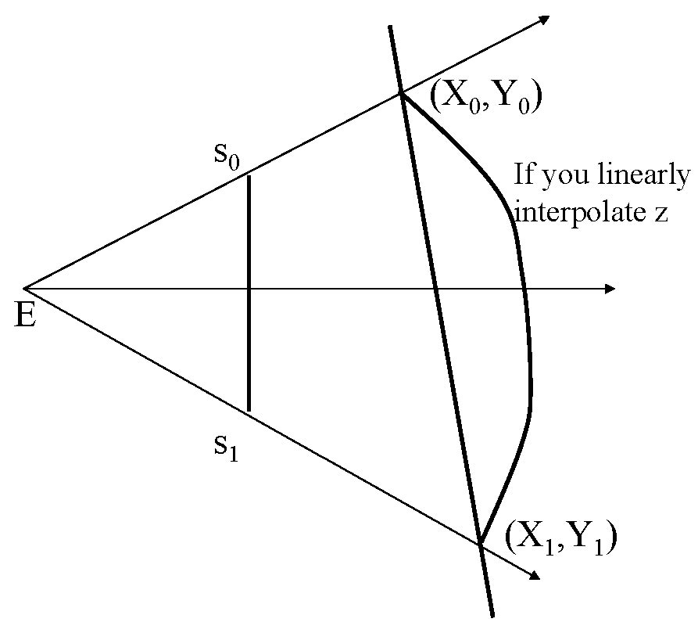
z-error

Slide 27
Z-Fighting
The perspective projection transformation maps z ∈ [-n, -f] to z’ ∈ [-1, 1] nonlinearly
This can cause floating-point precision issues when the range of [-n, -f] gets large
Z’
Z’

Slide 28
Perpendicular Parallel Projection
When eye is at infinity

