Slide 1
CS112: Shading

Slide 2
Shading
How to determine the color of each surface point?
Given a compete 3D scene with viewing/lighting conditions and object geometry and material properties fully specified
First at Vertices, then in the interior of the triangle
[cgtrader.com]

Slide 3
Shading
Interaction between light and matter
Physics of optics (and thermal radiation)
Very complex (e.g., light can bounce off several surfaces before reaching the eye)
Geometric optics
Light travels in straight line (in vacuum)
Neglects wave effects (e.g., diffraction and interference)
Need further approximations for interactive rendering
Simple and produces visually plausible results
Neglecting/approximating indirect illumination

Slide 4
Shading a Surface Point
Do NOT think of triangulated surfaces
All vectors are unit vectors
Monochromatic light (i.e., single wavelength)
L
N
R
V
α
θ
θ
Angle of Incidence
Angle of Reflectance
P
Surface

Slide 5
Ambient Reflection
Approximate interreflection (i.e., light bouncing off multiple surfaces)
Inaccurate
Directionally independent (i.e., equal contribution from all directions)
I_{a} = intensity of ambient light
k_{a} = percentage of the light reflected by the object
Coefficient of ambient reflection

Slide 6
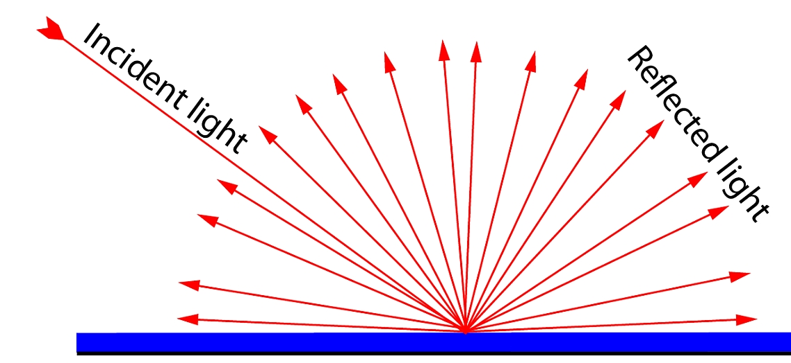
Diffuse Reflection
Approximate “body reflection” of rough surfaces
Equal amount of light reflected in all directions

Slide 7
Shading a Surface Point
I_{p} = intensity of light
k_{d} = diffuse coefficient
If light is at infinity, L is constant over the whole surface
L
N
R
θ
θ
P
Surface

Slide 8
Ambient and Diffuse Reflection

Slide 9
Diffuse Reflection
Did not take distance of the source from surface into account
d = distance of light from the surface
a, b and c are user defined constants

Slide 10
Falloff of Light
a=0, b=0, c=1
a=0.25, b=0.25, c=0.5
a=0, b=1, c=0
Increasing distance from the light source

Slide 11
Specular Reflection
Highlights on shiny surfaces
Amount of reflection changes with viewpoint
Think of a mirror, perfectly specular
Phong reflectance model
L
R
L
R

Slide 12
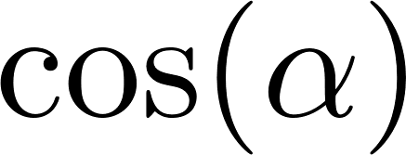
Phong Reflectance Model
: fall off as V moves away from R
n gives the sharpness
R
L
V
α
θ
θ
P

Slide 13
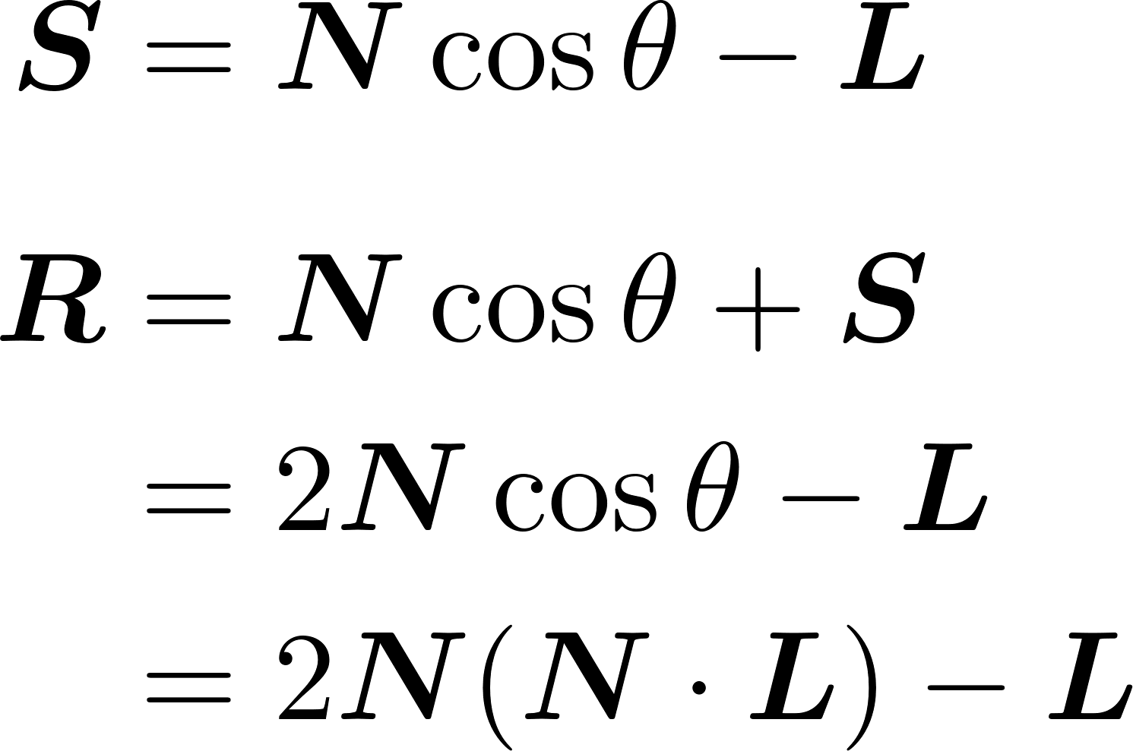
Phong Reflectance Model
Computing the reflected direction R:

Slide 14
Multiple Light Sources
Only one ambient light source
Multiple point/directional sources
Addition of light from different light sources
Can be slow when there are many light sources

Slide 15
Ambient

Slide 16
Ambient + Diffuse

Slide 17
Ambient + Diffuse + Specular

Slide 18
Chromatic Light
Ambient Light : (I_{aR}, I_{aG}, I_{aB})
Point (I_{pR}, I_{pG}, I_{pB})
May have diffused and specular components
(I_{dR}, I_{dG}, I_{dB}) and (I_{sR}, I_{sG}, I_{sB})
Object’s color by a RGB value: (O_{R}, O_{G}, O_{B})
ambient, diffuse and specular components
(O_{aR}, O_{aG}, O_{aB}), (O_{dR}, O_{dG}, O_{dB}), (O_{sR}, O_{sG}, O_{sB})
Multiply by object color

Slide 19
Chromatic Light
Each channel treated independent
Ambient : I_{aC}k_{a}O_{C}
Diffuse: f_{att}I_{pC}k_{d}O_{C}(N.L)
Specular: I_{pC}k_{s}(R.V)O_{C}
Total for each channel
O_{C}(I_{aC}k_{a} + f_{att}I_{pC}k_{d}(N.L)+ I_{pC}k_{s}(R.V))
Different components
O_{aC}I_{aC} + f_{att}O_{dC}I_{dC}(N.L)+ O_{sC}I_{sC}(R.V)

Slide 20
Multiple Light sources
Only one ambient light source
Multiple point light sources
Addition of light from different light sources

Slide 21
Shading in Interactive Rendering
How should we “shade” each pixel using the aforementioned models using the standard interactive rendering pipeline?

Slide 22
Shading in Interactive Rendering
Evaluate shading model at the vertices of the triangles
Normally in the eye/camera space (after model-view transformation)
Use interpolation to color the interior of the triangles during rasterization
Different shading methods use interpolation differently

Slide 23
Normal Computation
Normal of a triangle
Vertices are in anticlockwise direction with respect to normal
Normal of a vertex
Average of all the triangle incident on the vertex
A
N
C
B

Slide 24
Constant/Flat/Faceted Shading
Illumination model applied once per triangle
Using normal of the triangle
Shade the whole triangle uniformly
Color associated with triangles and not vertices

Slide 25
Gouraud Shading
Interpolating illumination between vertices
Calculate the illumination using vertex normals at vertices
Bilinear interpolation across the triangle

Slide 26
Gouraud Shading
Edges get same color, irrespective of which triangle they are rendered from
Shading is continuous at edges
Tends to spread sharp illumination spots over the triangle
Con: miss specular highlights within triangles

Slide 27
Phong Shading
Not to be confused with the Phong reflectance model
Interpolate the normal across the triangle
Calculate the illumination at every pixel during rasterization
Using the interpolated normal
Con: slower than Gouraud
Pro: does not miss specular highlights
Good for shiny specular objects

Slide 28
Gouraud vs. Phong Shading
Gouraud
Phong
Gouraud
Phong
Spreads highlights across the triangle
Misses a highlight completely

Slide 29
Flat Shading

Slide 30
Gouraud Shading

Slide 31
Phong Shading

Slide 32
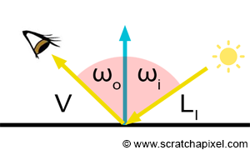
Beyond Phong Reflectance
Problem: the Phong reflectance model is NOT physics-based and does not closely resemble real-world materials
Bidirectional reflectance distribution functions (BRDFs):
Captures the fraction of light being reflected into direction V with incident direction L
The Phong reflectance model is one realization of this formulation

Slide 33
Bidirectional Reflectance Distribution Functions
To be physically plausible, a BRDF needs to be
Nonnegative
Reciprocal
Energy conserving
Empirical models
Phong, Blinn-Phong
Ward
Physics-based models
Microfacet
Cook-Torrance, Torrance-Sparrow, …

