Slide 1
CS112: Culling and Clipping

Slide 2
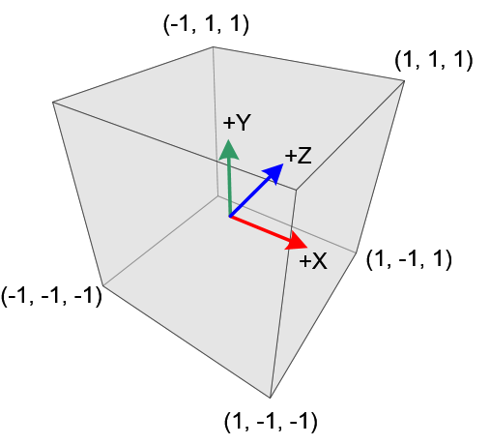
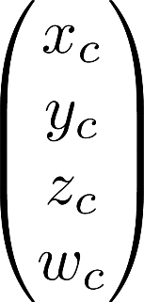
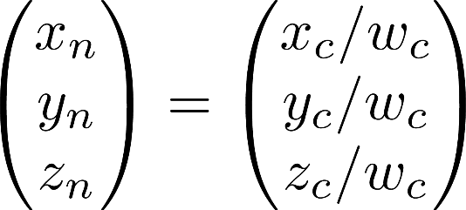
Clip Coordinates vs. NDC
Clip space (left-handed)
Clip coordinate
Normalized device coordinate (NDC)

Slide 3
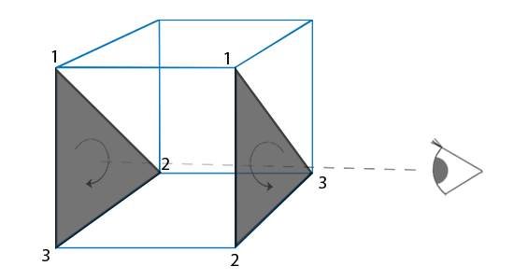
Culling
Culling: discarding invisible polygons
Back-face culling
Discarding all faces (i.e., polygons) that face “backward” (i.e., whose normals point away from the eye)

Slide 4
Clipping
Remove parts of primitives (e.g., lines and polygons) that are not visible
May need to generate new primitives
OpenGL performs clipping in the clip space (hence the name) against the view frustum (a cube)

Slide 5
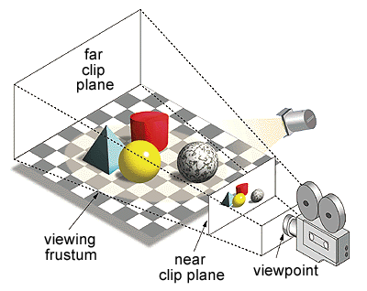
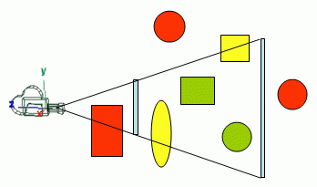
View Frustum Culling & Clipping
Red objects are fully outside (culling)
Yellow objects are partially outside (clipping)
Green objects are fully inside

Slide 6
Line Clipping in 2D
Clipping line segments using an axis-aligned window
In this example:
AB: accept
CD: discard (cull)
EF: clip (one endpoint outside the window)
GH: clip (both endpoints outside the window)
F
J
H
I
D
G
B
E
A
C

Slide 7
Cohen-Sutherland Clipping
Divide the window in nine regions marked by binary codes:
b₁ = y > y_{max} ? 1 : 0
b₂ = y < y_{min} ? 1 : 0
b₃ = x > x_{max} ? 1 : 0
b₄ = x < x_{min} ? 1 : 0
0000 corresponds to the interior of the window
1001
1000
1010
y_{max}
0001
0000
0010
y_{min}
0101
0100
0110
x_{min}
x_{max}

Slide 8
Cohen-Sutherland Clipping
Find binary codes of two endpoints (C₁, C₂)
C₁= C₂ = 0
Accept the line, both endpoints inside the window
C₁ = 0 or C₂ = 0 (but not both)
One endpoint outside the window
Nonzero bits give the lines with which to intersect
Maximum two intersection to get the clipped line
C₁ & C₂ != 0
Both endpoints outside the same edge of the window
Cull completely
C₁ & C₂ = 0
Both endpoints outside, but different edges
Find the first intersection and find its binary code
Apply recursively on this culled line
Check in this order

Slide 9
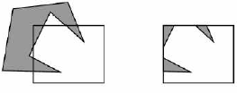
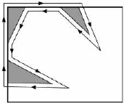
Polygon Clipping
Convex polygons clipped to a single polygon
Concave polygons
Clip and join to a single polygon
Tessalate and clip triangles

Slide 10
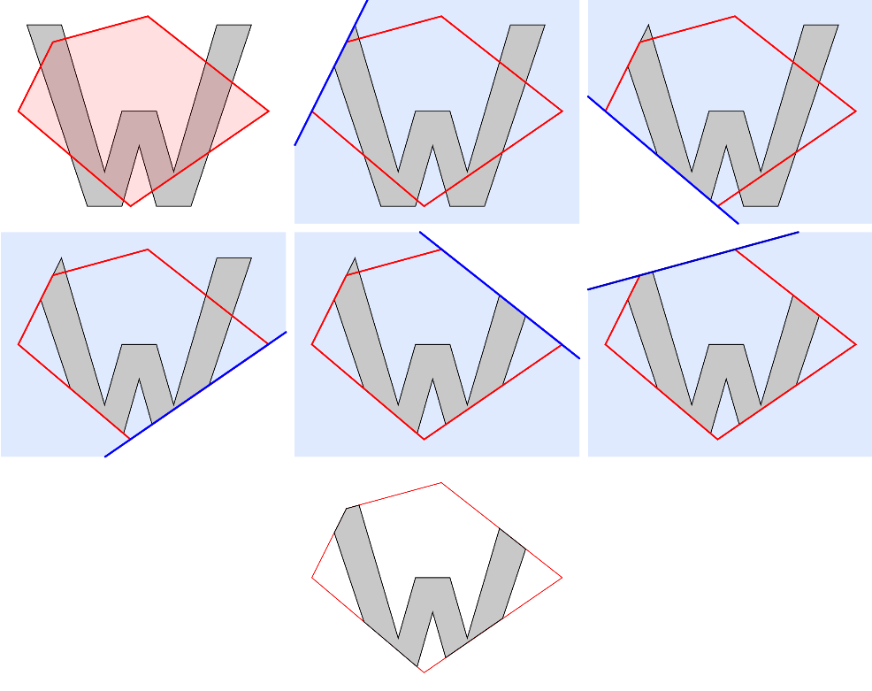
Clipping Convex Polygons
Sutherland-Hodgeman algorithm
Repeated clip a polygon using a clipping line
Clipping
line
Polygon

Slide 11
Sutherland-Hodgeman Algorithm
To clip a polygon against a line, one can examine its vertices one by one:
Test first vertex, output if inside else skip
Then loop through the list, testing transitions
In-to-out: Output intersection
In-to-in: Output vertex
Out-to-in: Output intersection and vertex
Out-to-out: Output nothing
Can be extended to 3D easily (line-plane intersection)

Slide 12
View Frustum Culling
Bounding Volumes
Axis-aligned
The planes of the box is aligned with the world coordinates
Object oriented
The planes are aligned to hug the object more closely
More rejections

Slide 13
Hierarchical bounding volumes/ Spatial Subdivision
Preprocessing
Hierarchically subdividing the frustum
Each box has a list of polygons inside it
An empty box is the leaf node
Octree

Slide 14
View Frustum Culling & Clipping
Culling Algorithm
If completely inside the view frustum
Accept
If completely outside the view frustum
Reject
If intersects the view frustum
Go through the children recursively
What happens when a triangle spans across a box?
Split the triangle
Include it in both boxes
Screen space clipping takes care of it

Slide 15
CS112: Polygon Scanning

Slide 16
Polygon Types
Convex
All interior angles are less than 180 degrees
Concave
Interior angles can be greater than 180 degrees
Can be splited into multiple convex polygons
Degenerate
If all vertices are collinear (zero surface area)

Slide 17
Identifying Concave Polygons
Using direction of cross products of adjacent edges
If the polygon lies within the XY plane, check the cross products’ Z coordinates: if all same sign, then convex; otherwise, concave
Y
E₅
E₁ X E₂ > 0
E₂ X E₃ > 0
E₄
E₃ X E₄ < 0
E₆
E₃
E₄ X E₅ > 0
E₂
E₅ X E₆ > 0
E₁
X

Slide 18
Triangulating a Convex Polygon
V₄
While there exists more than three vertices:
Take any three vertices in order
Output the triangle associated with the middle vertex
Throw away the middle vertex
V₅
V₃
V₆
V₂
V₁

Slide 19
Triangulating a Convex Polygon
V₄
V₁,V₂,V₃,V₄,V₅,V₆
(V₁,V₂,V₃): tri 1, remove V₂
V₁,V₃,V₄,V₅,V₆
(V₁,V₃,V₄): tri 2, remove V₃
V₁,V₄,V₅,V₆
(V₁,V₄,V₅): tri 3, remove V₄
V₁,V₅,V₆
(V₁,V₅,V₆): tri 4
V₅
V₃
V₆
V₂
V₁

Slide 20
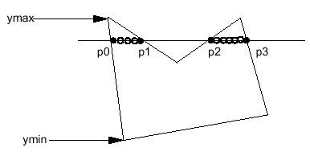
Polygon Rasterization
Basic idea: Intersecting a scanline with polygon edges and fill between pairs of intersections
Works for both convex and concave polygons
For y = y_{min} to y_{max}:
Intersect the scanline with all edges
Sort the intersections by increasing x: [p0, p1, p2, p3, …]
Fill pairwise: (p0, p1), (p2, p3), …

Slide 21
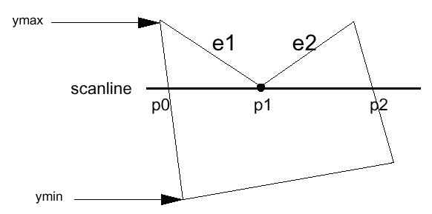
Corner Case: Edge Endpoint
Happens when intersecting right at an edge endpoint
Solution: duplicating the endpoint
[p0, p1, p1, p2], so we can still fill pairwise
If computing the intersection of the scanline with edges e1 and e2 separately, we will get the intersection point p1 twice
Simply keep both copies

Slide 22
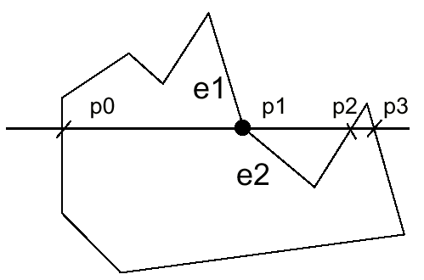
Corner Case : Edge Endpoint
But what about this case:
We want [p0, p1, p2, p3] (i.e., not duplicating p1)
Rule: Count an intersection at an edge endpoint only if its is at y_{min}
In the example above, count p1 for e1 but not e2

Slide 23
Scanning Polygon: Example
Horizontal edges do not need to be considered
Scanline 1
A – intersection of JA
B – intersection of BC
Result: [A, B]
AB is filled
G
F
H
I
E
J
D
C
A
B
Scanline 1

Slide 24
Scanning Polygon: Example
Scanline 2
J – intersection of IJ
Not of JA
C – no change seen
D – intersection of ED
Result: [J, D]
JD is filled
G
F
H
I
E
Scanline 2
J
D
C
A
B

Slide 25
Scanning Polygon: Example
Scanline 3
I – no intersection of IJ
H – intersection of GH
Result: [H, H’]
HH’ is filled
G
F
H
H’
I
Scanline 3
E
J
D
C
A
B

Slide 26
Scanning Polygon: Example
Scanline 4
G – no intersection of GH
F – no intersection of FE
Result: [] (empty list)
Nothing is filled
Scanline 4
G
F
H
I
E
J
D
C
A
B

Slide 27
Implementing the Scanline Algorithm
Brute force: intersect all the edges with all scanline
Too slow for complex scenes!
Goal: compute the intersections more efficiently
Find the y_{min} and y_{max} of each edge and intersect the edge only when it crosses the scanline
Only calculate the intersection of the edge with the first scan line it intersects

Slide 28
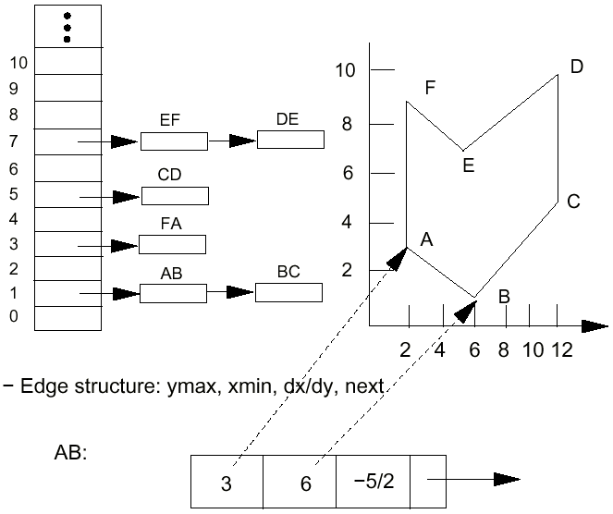
Edge Table (ET)
A separate bucket for each scanline
Each edge goes to the bucket of its y_{min} scanline
In each bucket, edges are sorted by increasing x of the y_{min} endpoint

Slide 29
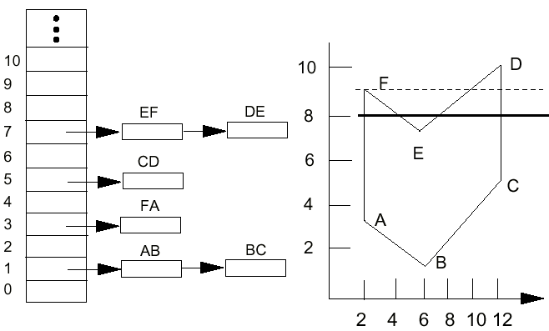
Active Edge Table (AET)
A list of edges active for current scanline, sorted in increasing x
y = 9
y = 8

Slide 30
Scan-Polygon Algorithm
construct the ET # edge table
AET = [] # active edge table
for y = y_{min} to y_{max}
merge-sort ET[y] into AET by x value
for each edge in AET:
if edge.ymax = y:
remove edge from AET
fill between pairs of x in AET
for each edge in AET:
edge.x = edge.x + dx/dy
sort AET by x value

