Slide 1
CS112: Texture Mapping
Shuang Zhao
Assistant Professor of Computer Science
University of California, Irvine

Slide 2
Announcements
PA1 due tomorrow
Remember to submit on time (especially if you turned in PA0 late!)
PA2 will be released afterward
This week’s discussions:
Shading & lighting concepts (closely related to PA2)

Slide 3
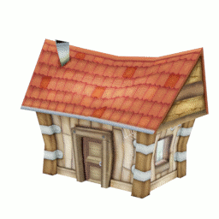
What is Texture Mapping?
Per-vertex color is insufficient for realistic appearance
Naïve solution: using very fine meshes
Problem: expensive!
Wrap (map) a image onto a surface (like gift wrapping)
Fragment colors are given by the image contents
Use high-resolution images to provide detailed appearance
[Wikipedia]

Slide 4
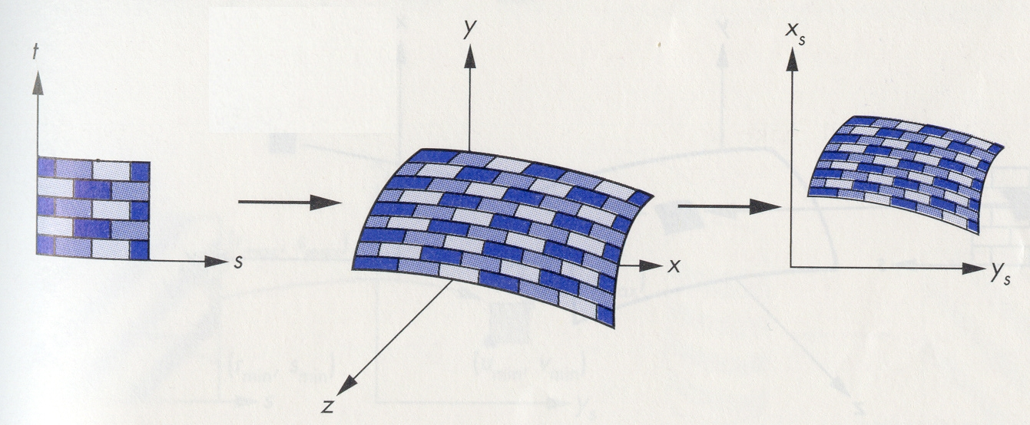
2D Texture Mapping
Three spaces
Texture Space
Screen Space
Object Space
Done by modeling
(providing per-point texture coordinates)
Done via rasterization

Slide 5
Texture Space to Object Space
Rectangular image mapped to arbitrary surfaces
Specified by assigning texture (aka. UV) coordinates to each point on the surface
The texture images will be stretched differently at different places on the surface (based on the curvature)
E.g., imagine wrapping a rectangular image on a sphere
Two methods: direct & indirect

Slide 6
Direct Method
Find the parametric representation of the surface defined by parameters (u, v)
Surfaces are 2D manifolds embedded in 3D
A parameterization of a surface is a (vector-valued) function f(u, v) which is typically continuous in u and v
For each vertex of a tessellated object at P = f(u, v), assign (s, t), a normalized version of (u, v), as the texture coordinate of P

Slide 7
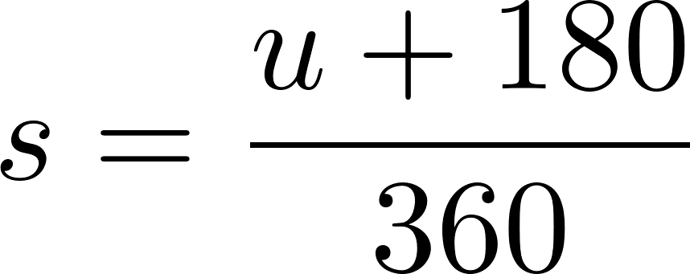
Example: Open Cylinder
Z
– angle, -180 ≤ ≤ 180
– height, 0 ≤ ≤ 1
Assign (s, t) to f(u, v):
Parameterization
u
X
v
Y

Slide 8
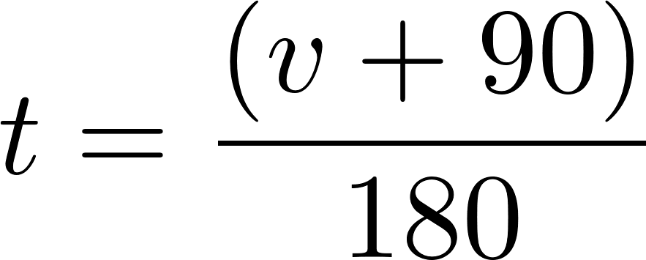
Example: Sphere
– horizontal angle
-180 ≤ ≤ 180
– vertical angle
-90 ≤ ≤ 90
Assign (s, t) to f(u, v):
Z
Parameterization
v
u
X
Y

Slide 9
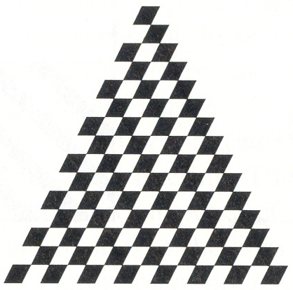
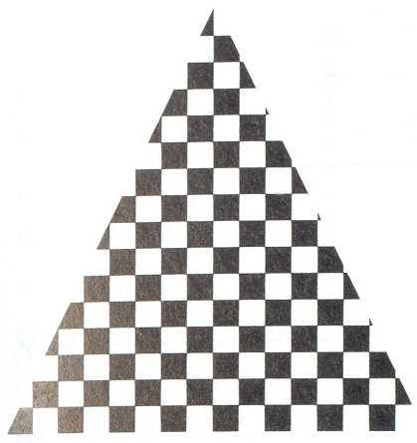
Results
v
u
v
Depends on the parameterization
u

Slide 10
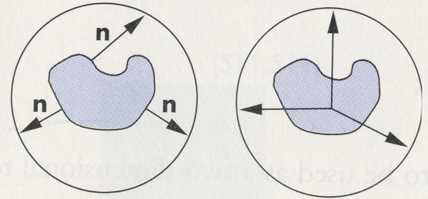
Indirect Method
Arbitrary geometry can be hard to parameterize
Solution:
Define intermediate simpler surface (e.g., plane, sphere, or cylinder) and parameterize it
Enclose arbitrary geometry within the intermediate one
More close these shapes are, better (i.e., more uniform) the mapping

Slide 11
Result (Planar Mapping)

Slide 12
Result (Cylindrical Mapping)

Slide 13
2D Texture Mapping
Three spaces
Texture Space
Screen Space
Object Space
Done by modeling
(providing per-point texture coordinates)
Done via rasterization

Slide 14
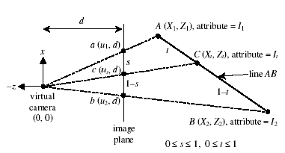
Object Space to Screen Space
The texture coordinates are known in the object space
Needs to be interpolated in the screen space

Slide 15
Interpolation of Attributes
(Linearly interpolate using 1/Z)

Slide 16
Sampling the Texture
How to query texture images using continuous texture coordinates?
E.g., evaluating I₁(u) for 1D texture I₁ or I₂(u, v) for 2D texture I₂ with u, v being floats between 0 and 1
Common sampling methods
Nearest neighbor
Linear
Mipmaping

Slide 17
Nearest-Neighbor Sampling
Let I₁ be a 1D texture with n pixels
To evaluate I₁(u) for some 0 < u < 1:
Let i = floor(n*u), which is an integer
Return I₁[i]
Returns the color of the pixel that is closest to u
This mode is called GL_NEAREST in OpenGL and produces pixelized results

Slide 18
Linear Sampling
Let I₁ be a 1D texture with n pixels
To evaluate I₁(u) for some 0 < u < 1:
Let i = floor(n*u), which is an integer
Let w = fract(n*u) = n*u – i, which is a float between 0 and 1
Return (1 - w)*I₁[i] + w*I₁[i + 1]
Linearly interpolates the values of two neighboring pixels
This mode is called GL_LINEAR in OpenGL and produces smoother results

Slide 19
Problem: Aliasing
Texture is inadequately sampled by the pixels
Typical aliasing

Slide 20
Anti-Aliasing (AA)
Ideally, we should render the image with more samples per pixel
E.g., 2x2 AA, 4x4 AA, …
But this is slow!

Slide 21
Prefiltering
Idea: subsampling the textures to reduce its frequency content
At render time, one queries color values from the subsampled image to reduce aliasing
The lower frequency content will make the sampling adequate

Slide 22
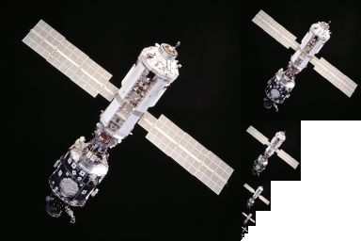
Mipmapping
Progressively subsample the original image into a number of levels
Up one level, half the resolution
Level 0
Level 1
Level 2
Level 3
[Wikipedia]

Slide 23
Mipmapping
Size: 4 x original texture
Special way of storing images of different resolutions
T₀: 128x128 (RGB)
T₁: 64x64 (RGB)
T₂: 32x32 (RGB)
…
T₀(R)
T₀(G)
T₁(R)
T₁(G)
T₀(B)
T₁(B)

Slide 24
Mipmapping
Which level to pick?
Nearest: picking one best level based on the screen space projection
Linear: interpolating between two neighboring levels
This is orthogonal to texture sampling
E.g., one can have nearest level + (bi)linear interpolation
When using linear everywhere, the sampling is called trilinear

