Slide 1
CS112: Bump and Environment Mapping
Shuang Zhao
Assistant Professor of Computer Science
University of California, Irvine

Slide 2
Announcements
PA2 to be released tonight
Will be due in two weeks
Please attend Friday’s discussion sessions

Slide 3
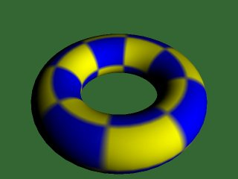
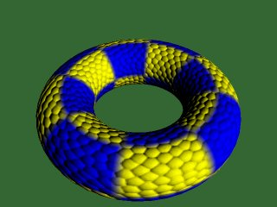
Bump Mapping
Goal: Simulate detailed geometry without adding actual geometry (i.e., vertices, faces)

Slide 4
Difference from Color Textures
Texture mapping cannot simulate rough surface details
Rough surfaces show illumination changes with the movement of the light or object
Textured objects cannot simulate that
Since independent of illumination parameters
Basic Idea
Perturb the normal and use the perturbed normal for illumination computation

Slide 5
Normal Perturbation Theory
u
N = P_{u} x P_{v}
P : Point on the surface
P_{u} : Tangent at P in u direction
P_{v} : Tangent at P in v direction
N : Normal at P
P’
P_{u}
P
P_{v}
v
Basic idea: displace each surface point P by adding a small perturbation B (aka. bump) along the normal N
Scalar
Point
Point
Vector

Slide 6
Normal Perturbation Theory
Calculating the perturbed normal at P’

Slide 7
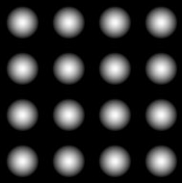
Implementation
Start with a gray scale texture B(u, v)

Slide 8
Implementation
Find the image B_{u}(u, v) by subtracting every pixel from its right neighbor

Slide 9
Implementation
Find the image B_{v}(u, v) by subtracting every pixel from its bottom neighbor

Slide 10
Implementation

Slide 11
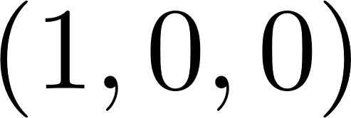
Implementation
These vectors define a local coordinate system at each surface point P
Not to be confused with the object coordinate space (which remains constant for all vertices)
N’ = (B_{u}, B_{v}, 1) is the perturbed normal in the local coordinate system at each surface point

Slide 12
Bump Mapping Remarks
The bump function B is only used to perturb surface normal and does NOT change the base geometry
Implementation
Store bump/normal maps as 2D textures
At render time, query these textures per point (i.e., fragment) instead of per vertex
Compute shading using perturbed normals

Slide 13
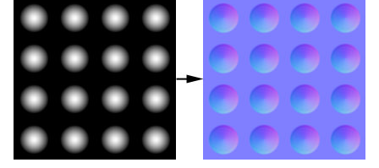
Normal Mapping
N’ = (B_{u}, B_{v}, 1) stored as RGB directly
Equivalent to bump mapping
Since the blue channel is always 1, it is bluish in appearance

Slide 14
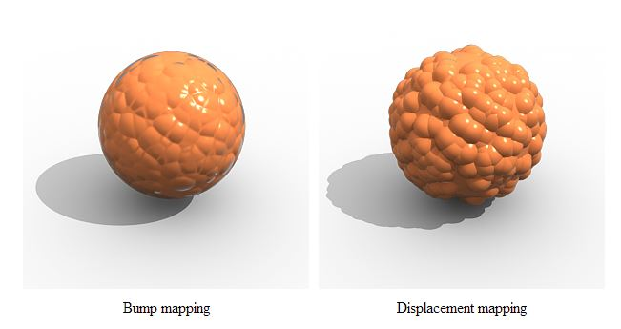
Displacement Mapping
Actually changes the underlying geometry
Much more expensive

Slide 15
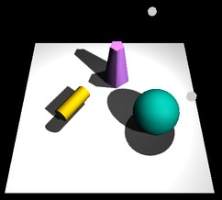
Environment Lighting
Simple light sources (e.g., point, directional) create unnaturally harsh illuminations
In reality, light usually come from all directions

Slide 16
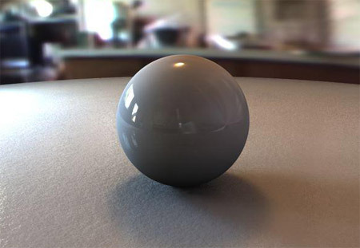
Environment Lighting
Environment lighting is capable of producing much more realistic results
[webtwoclub.wordpress.com]

Slide 17
Environment Map
A special type of texture used to specify environment lighting
Describe incident light from all directions
Generate the map of the environment
On a sphere, cube or paraboloid
Use a view-dependent mapping on the geometry

Slide 18
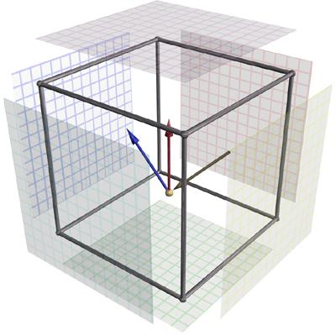
Cube Mapping
Each point P on the surface of the cube corresponding to a direction that goes from the center of the cube to P

Slide 19
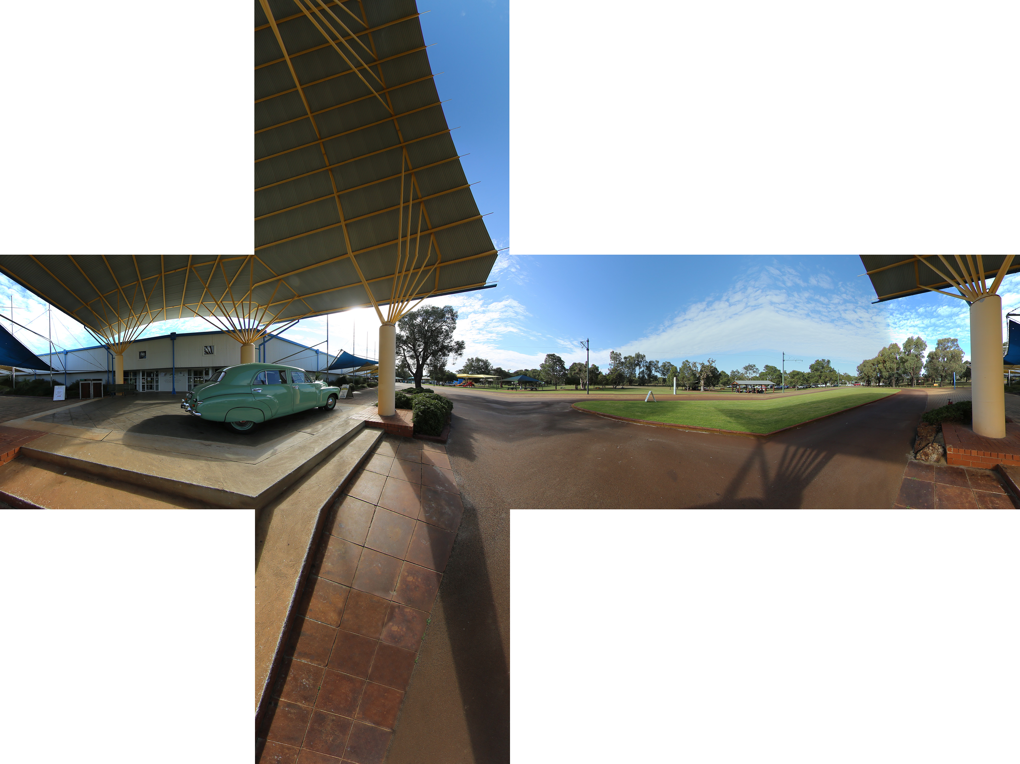
Cube Mapping
[http://paulbourke.net]

Slide 20
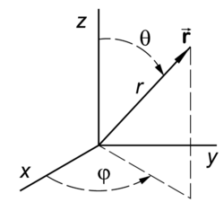
Spherical Projection
Recap: spherical coordinates
x = r sin(θ) cos(Ф)
y = r sin(θ) sin(Ф)
z = r cos(θ)
θ: elevation angle (0—180 degrees)
Ф: azimuthal angle (0—360 degrees)
When expressing unit vectors: r ≡ 1. Two variables remain:
Ф
θ

Slide 21
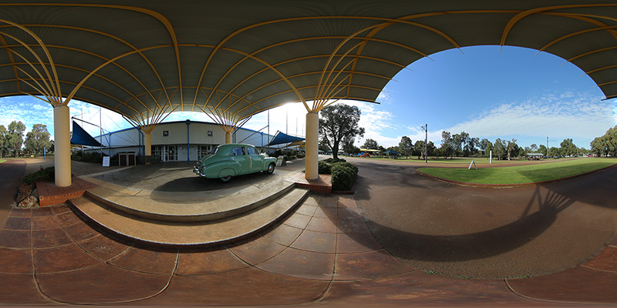
Spherical Projection
[http://paulbourke.net]

Slide 22
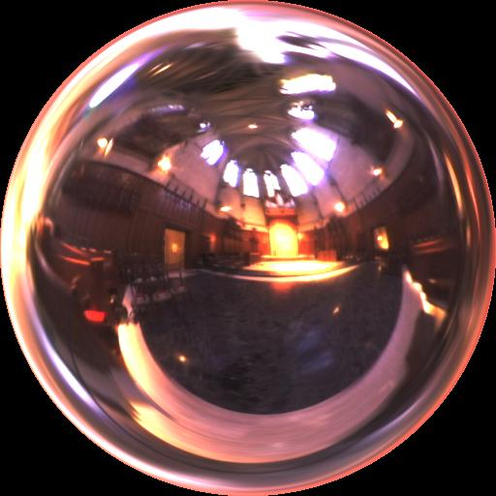
Generating Environment Maps
Using physical measurements
Light probe: taking pictures of a small spherical mirror (e.g., a stainless steel ball)
Using computer simulation
Ray tracing

Slide 23
Rendering with Environment Lighting
Consider the object to be enclosed within the environment
When the object is specular, the intensity I of each surface point equals incident light L_{i} coming from the reflected direction R:
I = L_{i}(R) = EnvMap(R)
V
N
R

Slide 24
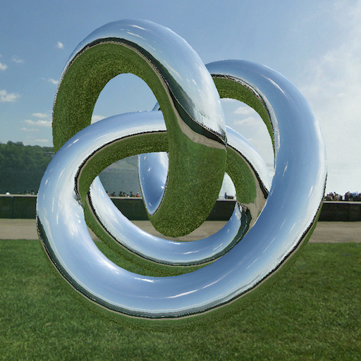
Rendering with Environment Lighting
Example (realistic reflection)

Slide 25
Rendering with Environment Lighting
Example (soft shadows)
[Dong et al. 2008]

Slide 26
Environment Lighting Remarks
Industrial standard in many applications (e.g., movies)
Accurate shading under environment lighting is challenging
Requires integrating incident light over all directions
Approximations are possible
Using prefiltered environment maps
Precomputed radiance transfer (PRT)

